Slide 1
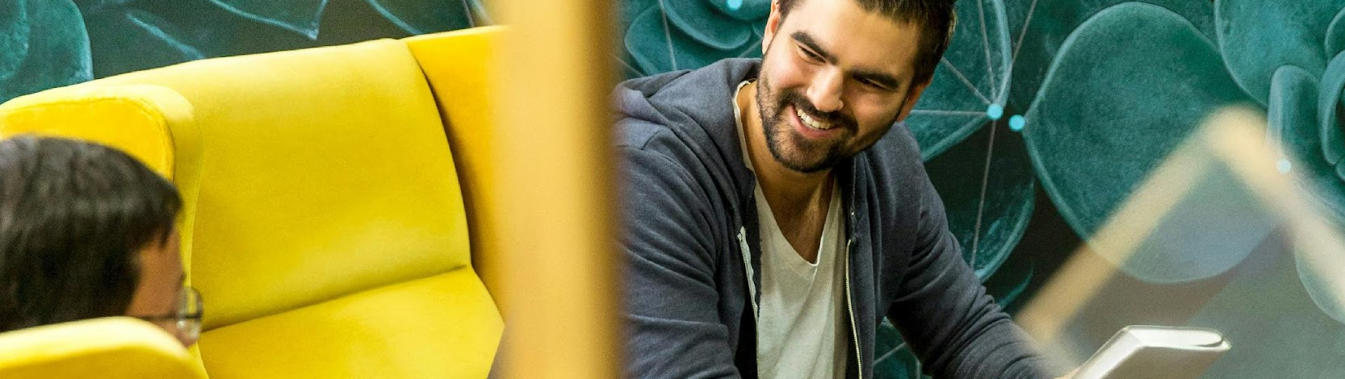

Start on Sustainability
Starter Kit
2. SUSTAINABILITY THINKING
Start on Sustainability Erasmus+ VET Project © 2024 is licensed under CC BY 4.0
Disclaimer: Funded by the European Union. Views and opinions expressed are however those of the author(s) only and do not necessarily reflect those of the European Union or the European Education and Culture Executive Agency (EACEA). Neither the European Union nor EACEA can be held responsible for them.

Slide 2

ABOUT OUR PROJECT
By implementing Start on Sustainability, we aim to equip micro-enterprises with the necessary tools and resources to take meaningful action towards sustainability, thereby contributing to a more sustainable and resilient EU economy.

Slide 3
SOS Starter Kit Table of Contents
UNIT NAME | UNIT NAME
Introduction to the SOS Starter Kit | Unit 7- Supply Chain Transparency
Unit 1- Sustainable Business Operations | Unit 8- Benchmark Practices
Unit 2- Sustainable Thinking | Unit 9- Digital Tools
Unit 3- Engaging Staff | Unit 10- Pitfalls in Sustainable Businesses
Unit 4- Serving Green Consumers | Summary to the SOS Starter Kit
Unit 5- Community Partnerships | Key Terms and Definitions
Unit 6- Assessment and Planning | References

Slide 4
TABLE OF CONTENTS
01
Introduction to the module
02
Sustainable Business Operations
03
Case Studies
04
Assessment
05
Key terms and definitions
06
References

Slide 5

01
INTODUCTION TO THE MODULE

Slide 6

01
OVERVIEW OF THE TOPIC
02
OBJECTIVES
03
LEARNING OUTCOMES

Slide 7
OVERVIEW - Sustainability thinking
1. What is "sustainability thinking"?
Sustainability thinking means an approach based on understanding and taking into account ecological, social and economic sustainability in all actions and decisions.
2. Objective
Sustainability thinking, or sustainable thinking, refers to the ability to maintain and process environmental, social and economic sustainability into all actions and decisions.

Slide 8
Definition of "sustainability" in business
Businesses continue to seek their own definition of "sustainability" and operational guidelines to help implement it. The interpretation of "sustainability" in business suggests that there is a possible "third way", a path of balance. It is emphasised that for sustainable development to be achievable, three goals must be reconciled:
Economic (material),
Environmental (natural),
and Social (human).
Special attention is paid to the need to maintain balance, harmony, and proper proportions among these three types of capital. It is only through this harmony that the sustainability of development is ensured.

Slide 9
Definition of "sustainability" in business
The common feature of all "sustainability" in business is attention to:
sustainability of the organization's development in the long term,
the need to sensibly balance today's aspirations and future opportunities
the fact that to achieve the above goals, it is necessary to seek a balance between the needs of various stakeholders and harmonise economic, social and ecological goals, as well as creativity, flexibility and the ability to learn to better understand and shape one's environment

Slide 10
In 1987, the United Nations Brundtland Commission defined sustainable development as "meeting the needs of the present without compromising the ability of future generations to meet their own needs.”It is safe to say that in the 37 years since then, humanity has not done enough to adhere to it. Today, the climate crisis has become an emergency, the global energy crisis has highlighted our continued dependence on planet-destroying resources, and younger generations are justifiably outraged by the damage and instability inherited from their predecessors.

Slide 11
However, according to a 2019 UN report, although 92% of CEOs believe that sustainability is important, only 48% find ways to implement sustainability measures. This is confirmed by a 2022 study by Deloitte, which showed a gap between ambition and action related to sustainable development practices in companies. For example, although a third of Europe's largest listed companies have committed to achieving net zero emissions by 2050, only 9% are on track to achieve this.

Slide 12
OBJECTIVES
The objectives of sustainability thinking include a series of tasks and long-term aspirations to achieve a balance between human needs and environmental protection. The main objectives of this approach are outlined below.
SUSTAINABILITY THINKING

Slide 13
All these goals are closely interconnected and mutually supportive. Achieving sustainable development requires a holistic approach that takes into account the interactions between the environment, society and the economy. By implementing sustainability thinking, we strive to create a better future for current and future generations, ensuring a balance between economic progress and environmental protection.

Slide 14
Sustainability thinking, is it worth it?
By implementing sustainability thinking, companies can not only minimize the negative impact on the environment, but also achieve benefits in the form of a better brand image, increased operational efficiency and access to new markets and customers. The information in this guide aims to provide valuable insights and guidance.
By integrating sustainability thinking into business operations, organizations can enhance their competitiveness, reputation, and resilience in a rapidly changing global landscape. This approach not only benefits the environment and society but also leads to more efficient and profitable businesses in the long run.

Slide 15
02
SUSTAINABLE BUSINESS OPERATIONS

Slide 16

01
Environmental protection
02
Education and public awareness
03
Promoting innovation and technological development
04
Consideration of social aspects
05
Sustainable use of resources
06
6. Ensuring long-term economic stability

Slide 17
OBJECTIVES TO BE FOLLOWED BY COMPANIES
Environmental protection
One of the main goals of sustainability thinking is to minimise the negative impacts of human activities on ecosystems. This includes reducing greenhouse gas emissions, protecting biodiversity, preventing soil degradation and protecting water resources. By keeping ecosystems in good shape, sustainability thinking prioritises the long-term ability of the Earth to sustain life.

Slide 18
2. Education and public awareness
As part of sustainability thinking, it is important to raise social awareness about sustainable development and promote education in this area. Improving the knowledge and skills of society can contribute to the widespread adoption of sustainable practices.
3. Promoting innovation and technological development
The aim of sustainability thinking is to stimulate innovation and technological development in order to create more effective and ecological solutions. The implementation of new technologies can contribute to achieving sustainable development goals in various sectors, such as energy, transport and agriculture.

Slide 19
4. Consideration of social aspects
Sustainability thinking also focuses on improving the quality of life of local and global communities. It pays attention to issues of social justice, equality of access to resources and ensuring decent working and living conditions for people.
5. Sustainable use of resources
The concept of sustainable development entails rational and efficient management of natural resources such as energy, water, mineral resources, and biodegradable materials. The goal is to ensure that the utilisation of these resources does not exceed their natural capacity for regeneration.

Slide 20

6. Ensuring long-term economic stability:
Sustainable development aims to promote economic efficiency while taking into account long-term economic stability. This includes pursuing economic development that does not cause irreversible damage to the environment or lead to the over-exploitation of resources.

Slide 21
Sustainable Business Operations
All these objectives are closely interlinked and mutually supportive. Achieving sustainability requires a holistic approach that considers the interactions between the environment, society and the economy. By implementing sustainability thinking, we aim to create a better future for present and future generations, ensuring a balance between economic progress and environmental protection.

Slide 22
BUSINESS STRATEGIES AND PRACTICES that are worth following
Future business leaders must think through sustainability strategy not just from the customer, product, or competitive point of view but also from the perspective of their own organisation's impact on society and the environment.
Expanding the topic of sustainability thinking in the context of sustainable business operations involves integrating sustainability principles into core business strategies and practices. Here are some key aspects:
Sustainable business includes a triple financial framework that addresses three key dimensions: economic prosperity, environmental stewardship and social justice. With this approach, companies evaluate their performance not only based on financial returns but also on their impact on people and the planet.

Slide 23
BEST PRACTICES AND STRATEGIES IN BUSINESS TO CONSIDER
Sustainability thinking in business operations emphasises resource efficiency and promotes a circular economy model. This involves minimising waste, maximising resource utilisation, and adopting practices such as recycling, reusing, and reducing resource consumption throughout the product lifecycle.
Businesses committed to sustainability thinking actively work to reduce their environmental footprint. This includes implementing energy-efficient technologies, reducing greenhouse gas emissions, conserving water, and minimising pollution and waste generation.

Slide 24
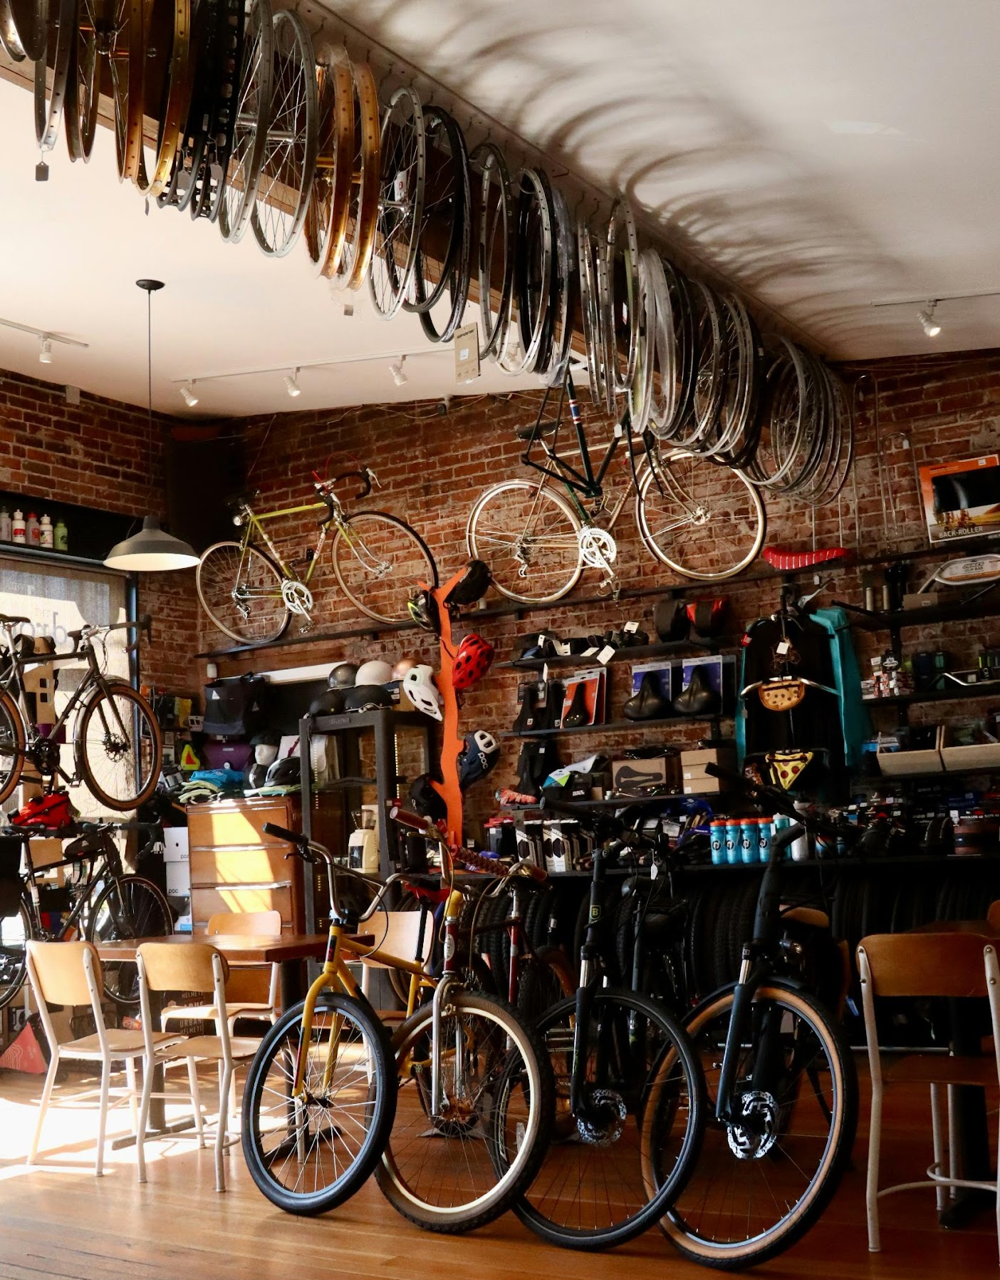
STEP BY STEP GUIDE ON HOW TO INTEGRATE SUSTAINABILITY THINKING INTO YOUR COMPANY'S OPERATIONS
Understanding of the topic by managers and owners
Impact Assessment and Situation Analysis
Planning and Strategy
Implementation and Action
Communication and Reporting
Continuous Improvement

Slide 25
How to start?
Implementing sustainability thinking in a company is a multi-stage process that requires the involvement of the entire organisation.
Conduct a discussion on sustainability goals and identify what values and objectives you want to achieve through sustainability thinking.
Conduct an analysis of your company's environmental, community and economic impact. Identify areas where improvements can be made.
Create a report or assessment of the current state.
Set specific sustainability targets that you want to achieve, e.g. reducing CO2 emissions by 20% in 5 years.
Encourage employees to participate and collaborate in sustainability initiatives, e.g. through training and incentive programmes.

Slide 26
MARKETING
Marketing is important in sustainability thinking. Effective use of marketing strategies can bring about a significant difference in promoting sustainable practices to customers, communities and other stakeholders.
Companies that actively engage in sustainability can use marketing to build a positive brand image based on the values of social and environmental responsibility. This, in turn, may attract customers who prefer sustainable and responsible brands.
Through appropriate marketing messages, companies can shape consumer preferences and encourage the choice of more sustainable products and services. Marketing can be a tool to highlight the benefits of using products that are eco-friendly among customers while supporting initiatives of local communities.

Slide 27
03
CASE STUDIES

Slide 28
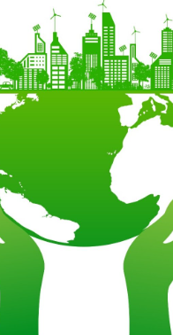
01
Case study 1: Edukacyjna Szkoła Hotelarstwa EHL
02
Case study 2: Zymetria
03
Case study 3: Siemens

Slide 29
EHL - Hospitality Business & Hotel Management School
The Educational Hotel School Lausanne (EHL has implemented an approach based on the concept of "people, planet and profit" , a concept that underpins their sustainability strategy.
EHL focuses on integrating sustainability into their curricula. They are implementing mandatory courses on business sustainability to educate future hospitality leaders about responsible resource management and minimising environmental impact.

Slide 30
EHL
As part of its sustainability efforts, EHL is developing climate plans to reduce its environmental impact. Long-term environmental goals include further reducing energy consumption, reducing waste production and managing water resources efficiently.
EHL engages with local communities by making their knowledge and skills available. They organise masterclasses in local restaurants that support vocational reintegration and support local community initiatives.

Slide 31
Zymetria is an innovative research and analytics company that combines expertise in marketing research, data science, and technology. They have developed the SUSTA package, designed to provide knowledge and tools for auditing, building sustainable strategies, ideating these strategies, executing them, and ultimately measuring their effectiveness.
ZYMETRIA

Slide 32
ZYMETRIA
Founded 10 years ago by managing partners Barbara Krug and Edyta Czarnota, Zymetria has been actively involved in supporting brand development, new product research, and business optimisation through research endeavors. Now, they are extending their expertise to include sustainable practices in business, assisting clients in gaining advantages in a rapidly evolving landscape.

Slide 33
Katarzyna Król, speaking on behalf of Zymetria, highlights their commitment to sustainability starting with themselves. They are the first and only research agency in Poland to calculate their carbon footprint for 2022, following the GHG Protocol and ISO-14064-1 standards (covering scopes 1, 2, and 3), and have defined reduction targets based on these assessments.
ZYMETRIA

Slide 34
Zymetria's approach not only involves providing practical recommendations based on expert knowledge and optimised research processes but also demonstrates a proactive stance toward sustainability by implementing initiatives internally and further extending these practices to their clients. Their comprehensive services aim to empower businesses to navigate and thrive in an era where sustainability is increasingly integral to success.
ZYMETRIA

Slide 35
SIEMENS
“The principles of sustainability are an integral part of Siemens' business - they are written into our DNA. We integrate them into all our activities, at every stage. We provide our customers and stakeholders with the tools to grow sustainably, transforming the industries in which they operate.”

Slide 36

04
ASSESSMENT

Slide 37
Q1
What are the main goals of „sustainability” in business?
Economic
Environmental
Social
All of them
None of them

Slide 38
Q2
In which year did the United Nations firstly define sustainable development?
1948
1987
2000
2016

Slide 39
Q3
Implementing sustainability thinking in a company is:
Single-stage process
Multi-stage process
An ad hoc activity

Slide 40
Q4
Please elaborate on the acronym for ESG
Environmental Supportive Goal
Environmental, Social, Governance
Energy Sustainability Goals

Slide 41
Answer Key
Q1: D
Q2: B
Q3: B
Q4: B

Slide 42

There is a path to sustainability.
It is a path that could lead to a better
future for all life on Earth
David Attenborough

Slide 43
05
KEY TERMS AND DEFINITIONS

Slide 44
Understanding these key concepts and definitions allows you to better understand and engage in sustainability, whether at an individual, organisational or societal level
Sustainable Development
Green Technologies
Greenhouse Gas Emissions
Corporate Social Responsibility (CSR)
Biodiversity
Zero Waste
Renewable and Non-renewable Resources
Responsible Consumption
Circular Economy
Sustainability Reporting
Renewable Energy

Slide 45
Sustainability Reporting
Sustainability Reporting, also called sustainability reporting or ESG (Environmental, Social, Governance) reporting, refers to the practice of publicly reporting an organization's performance on environmental, social and governance aspects. It is a key element of a sustainability strategy that enables companies, financial institutions, investors and other stakeholders to monitor, evaluate and compare sustainability performance.

Slide 46
CSR
Corporate Social Responsibility (CSR), or Corporate Social Responsibility in Polish, is a concept that refers to the responsible conduct of business activities by companies. This is an approach in which companies take into account the impact of their activities on society, the natural environment and the interests of all interested parties (stakeholders), not only profits.

Slide 47
Greenhouse gas emissions happen when gases are released into the air and make the Earth warmer. These gases trap heat from the sun in our atmosphere, which makes the planet hotter overall. The main greenhouse gases we worry about are carbon dioxide (CO2), methane (CH4), nitrous oxide (N2O), certain human-made gases, and water vapor.
Greenhouse gas emissions

Slide 48
“We don’t have to engage in grand, heroic actions to participate in change. Small acts, when multiplied by millions of people, can transform the world.”
Howard Zinn

Slide 49
06
REFERENCES

Slide 50
REFERENCES
https://hospitalityinsights.ehl.edu/sustainability-mindset-in-the-business-world
https://www.teraz-srodowisko.pl/
https://www.zymetria.pl/
https://www.siemens.com/
https://www.ironmountain.com/
Anna Witek-Crabb – Sustainability jako strategiczny wybór przedsiębiorstwa, Uniwersytet Ekonomiczny we Wrocławiu, 2022
Baumgartner, R.J. i Ebner, D. (2010). Corporate Sustainability Strategies

Slide 51

Thank You
Any questions?
www.website.eu

