Slide 1


Start on Sustainability
Starter Kit
CASE STUDIES
Start on Sustainability Erasmus+ VET Project © 2024 is licensed under CC BY 4.0
Disclaimer: Funded by the European Union. Views and opinions expressed are however those of the author(s) only and do not necessarily reflect those of the European Union or the European Education and Culture Executive Agency (EACEA). Neither the European Union nor EACEA can be held responsible for them.

Slide 2

ABOUT OUR PROJECT
By implementing Start on Sustainability, we aim to equip micro-enterprises with the necessary tools and resources to take meaningful action towards sustainability, thereby contributing to a more sustainable and resilient EU economy.

Slide 3
SOS Starter Kit Table of Contents
UNIT NAME | UNIT NAME
Introduction to the SOS Starter Kit | Unit 7- Supply Chain Transparency
Unit 1- Sustainable Business Operations | Unit 8- Benchmark Practices
Unit 2- Sustainable Thinking | Unit 9- Digital Tools
Unit 3- Engaging Staff | Unit 10- Pitfalls in Sustainable Businesses
Unit 4- Serving Green Consumers | Summary to the SOS Starter Kit
Unit 5- Community Partnerships | Key Terms and Definitions
Unit 6- Assessment and Planning | References

Slide 4

00
INTRODUCTION TO THE SOS STARTER KIT

Slide 5
01
SUSTAINABLE BUSINESS OPERATIONSC

Slide 6

01
Case study 1: IKEA Case Study: Implementing Solar Energy
02
Case study 2: All About Kombucha - Sustainable Innovation in Beverage Production
03
Case study 3: BiaSol - Revolutionising Food Sustainability

Slide 7
Introduction
IKEA, known worldwide for its flat-pack furniture and home accessories, has also been a leader in corporate sustainability efforts. Recognising the significant environmental impact and high operational costs associated with traditional energy use in their extensive global operations, IKEA embarked on an ambitious plan to transform its energy infrastructure.
The company aimed to reduce its carbon footprint and align its business practices with its sustainability ethos, which focuses on becoming climate positive and reducing more greenhouse gas emissions than the IKEA value chain emits by 2030.
Case Study 1
IKEA Case Study: Implementing Solar Energy

Slide 8
Problem
As a major retailer with vast store networks and warehouses, IKEA faced substantial energy demands. These not only led to high energy bills but also conflicted with its commitment to environmental sustainability. The reliance on non-renewable energy sources was at odds with IKEA’s vision to minimize its environmental impact and promote sustainable living among its customers.
Intervention
IKEA’s response was a strategic investment in solar energy. The company initiated a program to install solar panels on the roofs of its stores and warehouses globally. This was part of a larger commitment to renewable energy that aimed to make IKEA stores energy-independent, significantly reducing their reliance on fossil fuels and decreasing their carbon emissions.

Slide 9
Outcome
The solar energy initiative proved to be highly successful. IKEA significantly cut its energy costs and reduced its carbon emissions, moving closer to its goal of becoming a net positive contributor to the environment.
This initiative not only improved IKEA's operational sustainability but also strengthened its reputation as an environmentally responsible company.
The success of this project has encouraged IKEA to continue investing in renewable energy solutions and other sustainability projects, demonstrating its commitment to positive environmental impact.
Find out more by clicking on this link

Slide 10
Introduction
All About Kombucha was founded in 2017 in Galway, Ireland, by Keith Loftus and Emmett Kerrigan. The founders, inspired by kombucha’s health benefits discovered during a stay in Canada, aimed to introduce this health-promoting beverage to the Irish market.
However, they faced the challenge of doing so in an environmentally sustainable manner that would support local communities and align with their core values of causing minimal harm and promoting health.
Case Study 2
All About Kombucha - Sustainable Innovation in Beverage Production

Slide 11
To address this, All About Kombucha committed to a series of sustainable practices:
Sustainable Sourcing: They prioritised using organic ingredients to ensure the purity and environmental integrity of their products.
Carbon-Neutral Production: The brewery adopted carbon-neutral methods to minimize its environmental impact.
Zero-Waste Initiatives: Efforts were made to minimize waste throughout their production processes.
Support for Local Agriculture: The company became involved in regenerative agriculture projects and native tree planting, dedicating 10% of their brewery profits annually to these causes.
Community Engagement: Beyond production, they extended their product line to include tea kits and sustainable merchandise and held workshops to educate the community on sustainable practices and nutrition.

Slide 12
Outcome:
All About Kombucha’s comprehensive approach to sustainability has significantly enhanced their brand reputation, attracting environmentally conscious customers and contributing to community well-being.
Their commitment to environmental stewardship and local support has been instrumental in their expansion and resilience, demonstrating that business success and sustainability can go hand in hand.
The company’s initiatives such as membership in 1% for the Planet and extensive community engagement have not only ensured local goodwill but have also positioned them as a leader in sustainable business practices within the beverage industry.

Slide 13
Problem:
Founded in 2020 by siblings Ruairi and Niamh Dooley in Ireland, BiaSol was initiated to address food waste and promote sustainable nutrition by repurposing the abundant spent grain from the local craft beer industry.
This idea arose during a period of increasing global awareness around sustainable practices and healthier eating habits.
Navigating the challenges of integrating these sustainable practices into a viable business model, particularly the logistical issues related to handling and processing spent grain, was central to their mission.
Case Study 3
BiaSol - Revolutionising Food Sustainability

Slide 14
BiaSol joined the Food Waste Charter of Ireland in 2023, underscoring their dedication to reducing food waste and supporting sustainable industry practices.
Intervention:
BiaSol adopted several strategic approaches to overcome these challenges:
Repurposing Spent Grain: They innovated a method to dry and mill spent grain from local breweries, transforming it into a high-fiber ingredient suitable for various food products.
Product Development: Leveraging Niamh's expertise in food science, the team developed a diverse range of retail products based on spent grain, thus promoting a circular economy.
Community Engagement and Environmental Initiatives: The company committed to zero-waste manufacturing practices, which emphasized resource efficiency and minimal environmental impact. They also engaged in extensive community education efforts to promote sustainable living and responsible consumption.

Slide 15
Outcome:
Environmental Benefits: By converting spent brewing grain into nutritious food products, BiaSol has significantly reduced the amount of organic waste going to landfills, thereby cutting down on greenhouse gas emissions from waste decomposition.
Brand Impact and Community Relations: These sustainability efforts have not only elevated BiaSol's brand reputation as an innovator in sustainable food production but have also built a loyal consumer base that values ethical and environmentally conscious businesses.
Industry Leadership: BiaSol’s initiatives have established them as industry leaders, showing how sustainable practices can be effectively integrated into business models to benefit the environment, the community, and the economy

Slide 16
02
SUSTAINABLE THINKING C

Slide 17
01
Case study 1: Edukacyjna Szkoła Hotelarstwa EHL
02
Case study 2: Zymetria
03
Case study 3: Siemens

Slide 18
EHL - Hospitality Business & Hotel Management School
The Educational Hotel School Lausanne (EHL has implemented an approach based on the concept of "people, planet and profit" , a concept that underpins their sustainability strategy.
EHL focuses on integrating sustainability into their curricula. They are implementing mandatory courses on business sustainability to educate future hospitality leaders about responsible resource management and minimizing environmental impact.

Slide 19
EHL
As part of its sustainability efforts, EHL is developing climate plans to reduce its environmental impact. Long-term environmental goals include further reducing energy consumption, reducing waste production and managing water resources efficiently.
EHL engages with local communities by making their knowledge and skills available. They organize masterclasses in local restaurants that support vocational reintegration and support local community initiatives.

Slide 20
Zymetria is an innovative research and analytics company that combines expertise in marketing research, data science, and technology. They have developed the SUSTA package, designed to provide knowledge and tools for auditing, building sustainable strategies, ideating these strategies, executing them, and ultimately measuring their effectiveness.
ZYMETRIA

Slide 21
ZYMETRIA
Founded 10 years ago by managing partners Barbara Krug and Edyta Czarnota, Zymetria has been actively involved in supporting brand development, new product research, and business optimization through research endeavors. Now, they are extending their expertise to include sustainable practices in business, assisting clients in gaining advantages in a rapidly evolving landscape.

Slide 22
Katarzyna Król, speaking on behalf of Zymetria, highlights their commitment to sustainability starting with themselves. They are the first and only research agency in Poland to calculate their carbon footprint for 2022, following the GHG Protocol and ISO-14064-1 standards (covering scopes 1, 2, and 3), and have defined reduction targets based on these assessments.
ZYMETRIA

Slide 23
Zymetria's approach not only involves providing practical recommendations based on expert knowledge and optimized research processes but also demonstrates a proactive stance toward sustainability by implementing initiatives internally and further extending these practices to their clients. Their comprehensive services aim to empower businesses to navigate and thrive in an era where sustainability is increasingly integral to success.
ZYMETRIA

Slide 24
SIEMENS
“The principles of sustainability are an integral part of Siemens' business - they are written into our DNA. We integrate them into all our activities, at every stage. We provide our customers and stakeholders with the tools to grow sustainably, transforming the industries in which they operate.”

Slide 25
03
ENGAGING STAFF
C

Slide 26

01
Case study 1: The Business Case for People Engagement in Sustainability - O2
02
Case study 2: Employee Engagement in Sustainability at Bauer Media
03
Case study 3: How to Engage Employees in Sustainability - A Case Study by Unique

Slide 27
The Business Case for People Engagement in Sustainability - O2
The "Think Big" programme at O2, developed in collaboration with Global Action Plan, highlights how engaging employees in sustainability initiatives can drive both social and business benefits. This case study explores the programme’s impact on employee motivation, environmental outcomes, and financial returns.
Notes:
https://engageforsuccess.org/case-studies/the-business-case-for-people-engagement-in-sustainability-o2/

Slide 28
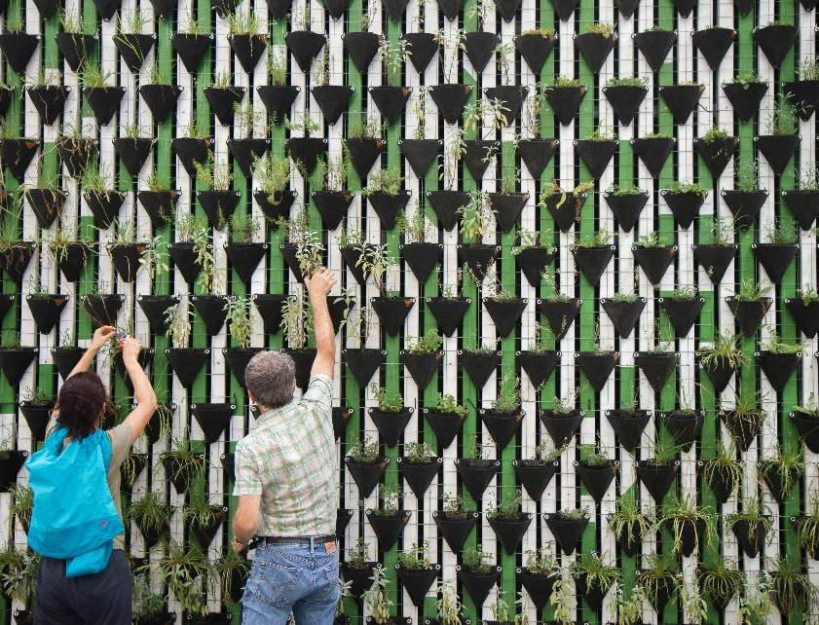
Enhancing Employee Motivation
When O2 launched the "Think Big" programme, employees were invited to propose and lead sustainability projects. This initiative not only empowered staff but also fostered a sense of ownership and pride. For example, an employee-led project on reducing plastic waste saw significant participation across departments, boosting morale and team spirit. Key Points:
Increased motivation and confidence
Improved team cohesion
Personal development through leadership opportunities.
"Taking part in 'Think Big' made me realise the impact I can have, both at work and in the wider community," – O2 participant.
Notes:
https://engageforsuccess.org/case-studies/the-business-case-for-people-engagement-in-sustainability-o2/

Slide 29
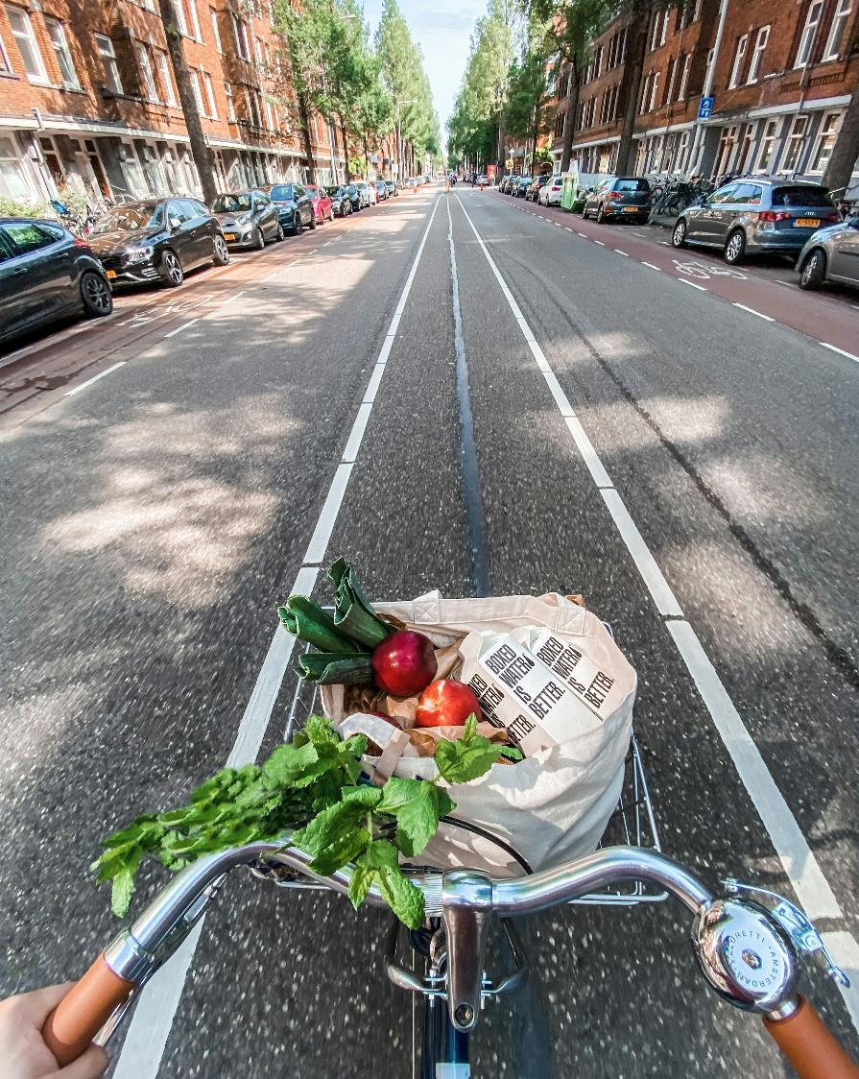
Environmental Impact and Savings
The programme led to several successful environmental initiatives, such as a campaign to reduce office waste. Employees collectively worked towards minimising paper usage and improving recycling practices, resulting in substantial cost savings and a noticeable reduction in the company's environmental footprint. Key Points:
Significant cost savings from waste reduction
Decreased water usage through efficiency measures
Promotion of sustainable practices within the organisation
Notes:
https://engageforsuccess.org/case-studies/the-business-case-for-people-engagement-in-sustainability-o2/

Slide 30
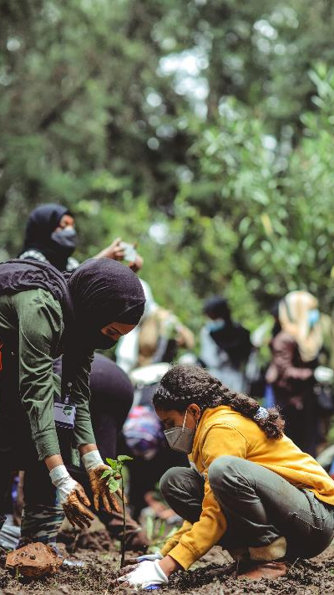
Financial Return on Investment
A detailed analysis of the "Think Big" programme revealed that for every £1 invested, O2 received £1.40 in return. This financial success story underscores the tangible benefits of integrating sustainability into business operations. One project, focused on energy efficiency, not only cut costs but also provided a learning experience for employees about sustainable practices.
Key Points:
Positive financial return: £1.40 for every £1 invested
Demonstrates the financial viability of sustainability initiatives
Notes:
https://engageforsuccess.org/case-studies/the-business-case-for-people-engagement-in-sustainability-o2/

Slide 31

Encouraging Industry Collaboration
O2’s success with "Think Big" serves as an inspiration for other companies. The programme's achievements demonstrate the power of employee engagement in driving sustainability and business benefits. O2 encourages other businesses to share their data and experiences to build a collective understanding of the value of sustainability initiatives. Key Points:
Call for businesses to share data and experiences
Importance of collective efforts in sustainability
“We believe that by working together, businesses can amplify the impact of their sustainability efforts," – O2 spokesperson
Notes:
https://engageforsuccess.org/case-studies/the-business-case-for-people-engagement-in-sustainability-o2/

Slide 32
Employee Engagement in Sustainability at Bauer Media
Bauer Media, led by the GoLoud For Good Committee, has embarked on a sustainability journey focusing on employee engagement. This case study explores their initiatives, challenges, solutions, and results.
Notes:
https://sustainablemedia.ie/case-studies/employee-engagement-in-sustainability-at-bauer-media/

Slide 33

Challenges and Solutions
Challenge:
Sustainability was a new topic for Bauer Media, requiring demonstration of leadership in this area.
Solution:
Formation of the GoLoud For Good Committee by three leaders: Zara Flynn, Adrian Barry, and Márese O’Sullivan.
Focus on internal sustainable practices and encouraging colleague participation.
Upskilling through a six-week Learning Waves training programme.
Notes:
https://sustainablemedia.ie/case-studies/employee-engagement-in-sustainability-at-bauer-media/

Slide 34

Initiatives and Employee Engagement
Initiatives:
Conducted an employee survey to gauge opinions on sustainability.
Regular newsletters and communication campaigns on topics like waste and water.
Partnerships with Food Cloud, Clean Coast, and the Irish Wildlife Trust for staff volunteer opportunities.
Success Story:
A pre-Christmas party clothes swap event, resulting in high participation and new outfits for employees.
Notes:
https://sustainablemedia.ie/case-studies/employee-engagement-in-sustainability-at-bauer-media/

Slide 35

Achievements and Future Plans
Achievements
Enhanced awareness and participation in sustainability initiatives.
Successful internal campaigns and events, fostering a culture of sustainability.
Future Plans
Second clothes swap event with an expert speaker on sustainable fashion.
Participation in Ad Net Zero to address the carbon footprint of marketing activities.
Continued focus on both environmental and social issues.
Notes:
https://sustainablemedia.ie/case-studies/employee-engagement-in-sustainability-at-bauer-media/

Slide 36
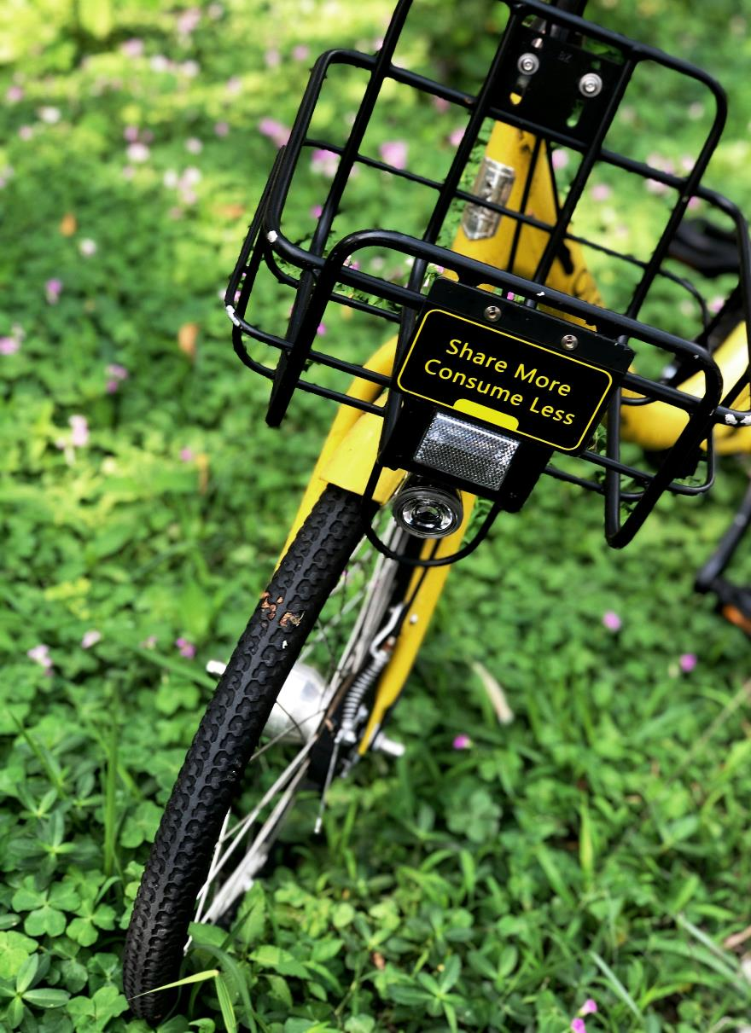
Lessons Learned and Call to Action
The journey taught Bauer Media valuable lessons on fostering a sustainable workplace. Key learnings included the importance of dedicated teams, leadership support, and regular communication. Key Learnings:
Dedicated sustainability team with rotating leadership.
Strong top-down support.
Regular communication and employee surveys.
Recognition of employees' efforts.
Forming diverse partnerships.
"We believe that by working together, businesses can amplify the impact of their sustainability efforts," - Zara Flynn.
Notes:
https://sustainablemedia.ie/case-studies/employee-engagement-in-sustainability-at-bauer-media/

Slide 37
How to Engage Employees in Sustainability - A Case Study by Unique
Unique, a company based in Belgium, wanted to participate in De Warmste Week, an annual fundraising event for good causes. To do this, they developed an innovative approach to engage their employees in sustainability and fundraising efforts.

Slide 38

Unique's idea was to involve employees by allowing them to auction their talents. This created a fun and competitive environment where employees could bid on each other’s talents, with all proceeds going to De Warmste Week.
Key Points:
Employees propose and auction their talents.
Others bid on the talents they like, sparking competition.
All funds raised support De Warmste Week.
"Our goal was to make sustainability fun and engaging for everyone involved," - Unique’s community manager.
The Concept
Notes:
https://www.ambassify.com/blog/how-to-engage-employees-in-sustainability

Slide 39

Steps to Engagement
Unique used Ambassify to roll out their campaign in several steps, ensuring clarity and maximum participation.
Step 1: Initial Campaign Created a form campaign explaining the initiative. Encouraged employees to participate by submitting their talents.
Step 2: Promotion Promoted the campaign to generate buzz and more submissions. Highlighted examples of talents already submitted.
Step 3: Participation Guidelines Explained how the bidding process worked. Used a clear, engaging tone with visuals and emojis. Employees confirmed understanding by clicking “I understand it” button.

Slide 40

Results and Impact
The initiative led to a diverse array of talents being auctioned, from fun activities to unique skills. Employees from different departments and regions participated, strengthening team bonds and revealing hidden talents.
Key Points:
High engagement across the company.
Creation of a custom tab for De Warmste Week.
Separate version for French-speaking employees under “Viva for Life.”
Example: One popular talent was a guaranteed fun night out with colleagues in Leuven, which saw enthusiastic bidding.

Slide 41
Benefits and Lessons Learned
Unique’s campaign not only supported De Warmste Week but also had several internal benefits. It drew non-participating employees into the ambassador community and fostered a collaborative spirit.
Key Learnings:
A dedicated team with rotating leadership.
Strong support from top management.
Regular communication and employee surveys.
Recognition of employee efforts.
Diverse partnerships enhance engagement.
"This initiative not only supported a great cause but also brought our team closer together" - one participant.

Slide 42
04
SERVING GREEN CONSUMERS
C

Slide 43

01
Case study 1: A case study from Vietnam
02
Case study 2: A case study from Qingdao, China.
03
Case study 3: Influencing Factors for Sustainable Dietary Transformation—A Case Study of German Food Consumption.

Slide 44
CASE STUDY 1
Determinants of green consumer behavior: A case study from Vietnam
This study uses a survey to investigate factors affecting green consumption behaviour. The demographic data shows both males and females are interested in green consumption habits, with the majority being young, educated individuals.
Previous research on green consumption has identified environmental knowledge and attitude factors as key factors. It emphasizes the importance of customers' attitudes towards green consumption, their concerns about environmental issues, and their impact on others.
Businesses should incorporate these factors into their long-term strategic planning to increase green purchasing. To draw customers' attention to green products, businesses can use promotion methods, provide hands-on learning opportunities, and foster a positive perception of their usefulness.

Slide 45
The study investigates the factors influencing green consumption behaviour, focusing on attitudes, societal norms, and environmental concerns. It found that consumers with a positive attitude towards green products are more likely to purchase them. Environmental concerns are also crucial, with consumers who are more concerned about the environment and have relevant knowledge being more likely to purchase green products.
Awareness of green consumption behaviour has no significant impact on it, but indirectly affects other factors. Consumers perceive that using green products will help protect the environment and have a positive attitude when buying, consuming, and promoting green products. The research is significant for understanding customers' green consumption habits and guiding businesses in capturing and tapping into people's psychology to build marketing and advertising strategies.

Slide 46
CASE STUDY 2
What affects green consumer behaviour in China? A case study from Qingdao.
The study explores green consumer behavior in China, examining personal influence, knowledge of green consumption, attitudes, internal and external moderators, and behavior. The rapid urbanization and industrialization in China could significantly influence consumers' attitudes and behaviour.
The study investigates green consumption in China, incorporating internal and external moderators to understand the factors influencing it. It focuses on three aspects: purchasing, using, and recycling. The approach is novel, providing more precise results and recommending policy options for the Chinese government.

Slide 47
Attitudes are the most significant predictor of purchasing behavior, while income, perceived consumer effectiveness, and age determine usage behavior. Recycling behaviour is strongly influenced by using behaviour. Environmental technologies, economic policies, and social initiatives are crucial for economic sustainability, but their impact depends on changing consumption patterns and behavior.
Green consumption is a key element in academic and policy debates, with factors such as demographics, environmental knowledge, attitudes, values, and internal and external moderators influencing it. However, approaches like the Theory of Planned Behavior (TPB) have limitations, such as the complexity of integrated models and the lack of correlation between value variables and household electricity conservation.

Slide 48
CASE STUDY 3
Influencing Factors for Sustainable Dietary Transformation—A Case Study of German Food Consumption.
A case study in Germany compared food consumption with sustainability pillars and dietary recommendations. The study found that purchasing decisions are largely influenced by health-related factors and few consumers align their diets with low environmental impact. A large portion of consumers opt for cheap foods, regardless of health and environmental consequences. Price is the main factor in food choices from a sustainability standpoint. Policymakers should financially incentivize consumers for healthy and environmentally friendly diets to prevent unhealthy consumption. Economic factors also influence food choices, with higher costs of plant-based and organic products leading to unhealthy habits.

Slide 49
This study also explores the factors influencing German consumers' dietary choices, revealing the gap between sustainable dietary patterns and actual consumption habits. It highlights the current food market's limitations and suggests that more educational campaigns could help promote healthier eating habits. Nutrition education could be a valuable tool for developing effective educational strategies.
German consumers are increasingly adopting environmentally conscious diets, but there is a gap between their commitment to sustainable products and actual consumption. Research is needed to understand consumer motivation and willingness to change. Cost of groceries can influence dietary decisions, with low prices of unsustainable options leading to high consumption. However, a nutritionally adequate diet can be purchased for lower expenses. Policymakers should encourage healthier, environmentally sensible dietary patterns with economic incentives and focus on best practices for transforming dietary trends towards health and ecological sustainability.

Slide 50
05
COMMMUNITY PARTNERSHIPS C

Slide 51
01
Case study 1: Starbucks
02
Case study 2: Allegro
03
Case study 3: H&M

Slide 52
Starbucks has a long history of community engagement and partnerships with local communities. Some of their notable activities are:
Sustainable coffee cultivation, which supports local coffee producers and protects the environment,
Youth training programmes, charity events.
In 2020, the brand has collaborated with EcoBean, a startup and is supporting it in its work on the possibilities offered by grounds processing - mainly by donating the waste collected in Warsaw cafés for tests on the reuse of the raw material. This aligns with most of the cafe’s guests who live the idea of zero waste on a daily basis.
Starbucks

Slide 53
Availability of the brand's products in the "Too Good To Go" application, whose mission is to reduce food waste.
Since the beginning of its operations in Poland, Starbucks has been developing the "Bring Your Own Tumbler" initiative, which aims to reduce waste production and educate society. The "With your own cup" concept was created keeping the environment in mind and spreading good practices among guests,
Cooperation with PSONI, i.e. the Polish Association for People with Intellectual Disabilities.
The brand also decided to support one of the Finales’ of the Wielka Orkiestra Świątecznej Pomocy.
Starbucks

Slide 54
“Sustainable development and social activity are embedded in Allegro's DNA, and responsibility for our customers, sellers, employees and care for the environment are our most important obligations.”
The overriding commitment for all areas of activity is to act ethically and with full transparency:
Providing a creative and innovative workplace,
Taking care of our customers,
Responsible cooperation in business ,
Investment in the community,
Creating a healthy and green attitude.
Allegro

Slide 55
Allegro
Examples of Allegro activities:
Allegro Lokalnie: Local community support. Allegro Lokalnie are mainly private individuals who most often offer single copies of a given product.
Allegro engages in charitable activities by supporting various non-governmental organizations and foundations.
Recycling packaging or promoting ecological products on the platform.
The company supports various cultural and artistic initiatives by organizing events promoting local artists and creators.

Slide 56
Another example of a European clothing company engaging in social activities and sustainable development is H&M. H&M is an international clothing retailer known for its efforts to promote responsible fashion and social involvement.
Use of organic materials, recycling of fabrics or reduction of water and energy consumption in the production process.
Support for local production communities in the countries where H&M garments are produced.
H&M works to address poverty and support local communities through charitable initiatives and partnerships with non-profit organizations.
H&M

Slide 57
06
ASSESSMENTS AND PLANNING
C

Slide 58
01
Case study 1: VOLCÁN STUDIO

Slide 59
Case study 1: VOLCÁN STUDIO
Volcan Studio is an architecture, engineering and design studio founded in 2015. Since its beginnings, it understands project management through a global vision where formal, graphic and material creation is nourished by a multidisciplinary approach.
Architecture is at a turning point in its evolution in the Canary Islands. Combining design, functionality and technique, it has a determining impact on the environment in which the company is located.
Therefore, while Volcán Studio is building the urban landscape and renovating the spaces, two key terms emerge: sustainability and accessibility.
CASE STUDY 1

Slide 60
Sustainability is not only about building environmentally friendly buildings, but also about constructions that can last over time, generating a positive impact on their surroundings.
On the other hand, accessibility seeks to make these spaces universal, so that citizens can enjoy them, regardless of their physical or sensory abilities and how these change as the population ages.
Looking into the future, there is a firm commitment towards these two dimensions, which are considered cornerstones in the architectural development of the Canary Islands and the world.
CASE STUDY 1

Slide 61
And not just because they represent the right thing to do in ethical terms, but because they are the answer to the demographic and environmental challenges we will face in the near future.
Volcán Studio believes that the best way to do this is to keep up with the times by incorporating the necessary
technology and the necessary knowledge that allows them to move forward on a sustainable and accessible path.
A good example of this is the participation in the "Aje Verde" programme, where they were made aware of the management of materials and the implementation of future legal regulations and national and international quality labels.
CASE STUDY 1

Slide 62
With the aim of advancing along this path and being a meeting point for professionals and knowledge, the initiative "Canarias Arquitectura Sostenible" (Canary Islands Sustainable Architecture) was born, which Volcán Studio joins.
It aims to give visibility to the initiatives arising from the Canary Islands and which are adapted to the particularities and singularities of the territory.
https://canariasarquitecturasostenible.com/
volcanstudio.com
CASE STUDY 1

Slide 63
07
SUPPLY CHAIN TRANSPARENCY

Slide 64
01
Case study 1: ECOEMBES
02
Case study 2: CONSTRUCTION SECTOR IN SPAIN AND ENERGY EFFICIENCY
03
Case study 3: IMPACT HUB

Slide 65

Case study 1: ECOEMBES
Ecoembes, is a spanish well-known environmental non-profit organization, that carries out the recycling and eco-design of packaging in Spain, and has several programs for supporting SMEs through guides and training.
In its VIII Business Prevention Plan (2021-2023), it highlights that 62% of all professional SME projects are already aware of the need to limit the environmental impact of their activities. They are moving towards a circular economy by focusing on both recycling packaging and improving packaging design to enhance recyclability
The most frequent decisions regarding a greener design of their companies' packaging revolve around the idea of improving the recyclability of such packaging, and that the recycled material is also incorporated into the manufacturing phase.

Slide 66
However, progress is still needed on other equally important ethical and ecological issues, such as reducing the weight of packaging for all types of products and optimizing space to minimize packaging. Additionally, using materials that have a lower environmental impact from the outset is crucial. More radical measures, such as bulk purchasing and the use of reusable packaging, are also becoming more common.
The movement among SMEs in Spain toward using less polluting packaging has been significant, yielding impressive results. Over 2,000 Spanish SMEs have adopted these practices, leading to substantial achievements. According to the report, more than 60,000 tonnes of raw materials have been saved, over 4 billion containers have been improved, and nearly 1 million tonnes of CO2 emissions have been avoided.

Slide 67
Case study 2: PEFC SPAIN
PEFC Spain is a non-profit, non-governmental organization that promotes and disseminates Sustainable Forest Management, through forest certification and the chain of custody of forest products.
This contributes to environmental and biodiversity conservation and promotes the social economy, circularity and sustainable development.
PEFC provides foresters, forest owners and managers, from small to large property, with a tool to demonstrate their responsible practices, while helping consumers and businesses choose sustainably sourced forest products.
In this case study we will analyze the case of construction projects. The construction industry faces the challenge of proving that the wood supplied in the various projects comes from certified sustainable sources. Chain of Custody certification is not always the most efficient option for these short-term projects involving different non-certified SME and micro-SME contractors.

Slide 68
Many contractors of all sizes will be involved in the project and not all will have their own Chain of Custody certification, specially the smaller ones.
Project certification allows non-certified subcontractors to work under the "umbrella" of prime contractor certification, as long as all of their activities are limited to the certified project.
The certification of the wood or its derived products used in the project provides an independent guarantee that it comes from sustainably managed forests, ensuring traceability through each stage of the production process, from the forest to the final project.
This type of certification makes visible the organization's commitment to the sustainable management of forests, in line with the 2030 Sustainable Development Goals and the fight against climate change.

Slide 69

Case study 3: SIGRE
SIGRE is a Spanish non-profit organisation in charge of guaranteeing the correct environmental management of the packaging and remains of medicines that are generated in homes.
Launched in 2001 as a result of collaboration between the pharmaceutical industry, pharmacies, and pharmaceutical distribution companies, this initiative aims to be an effective and efficient model
One of its greatest achievements has been to involve the entire value chain of the medicine, especially the pharmacy network in the project. 100% of pharmacies in Spain are micro-SMEs.

Slide 70
SIGRE not only establishes the collection points for expired or leftover medicines at pharmacy points and organises their collection, but also trains pharmacy professionals and offers consultancy on sustainability, eco-design and traceability of medicines in order to prevent them from becoming non-recyclable waste.
Such drugs are extremely harmful to the environment. Additionally, they are able to affect the entire food chain through wildlife and generate serious public health problems.

Slide 71
08
BENCHMARK PRACTICES
C

Slide 72
01
Case study 1:Lyft
02
Case study 2: Patagonia
03
Case study 3: Danone

Slide 73
CASE STUDY 1
Lyft, a $11 billion ride-hailing company, has been criticised for contributing to emissions and increasing congestion. In 2017, Lyft shared its 2025 climate impact goals, which include a switch to autonomous electric vehicles powered by renewable energy and reducing overall CO2 emissions in the transportation sector. The company has also invested in making all its rides carbon neutral, directly funding emission mitigation efforts such as reducing emissions in the automotive manufacturing process, renewable energy programs, forestry projects, and landfill emissions capture. By 2019, Lyft spent over $2 million on carbon credits, equivalent to 2,062,500 metric tons of carbon.

Slide 74
The company's efforts to go carbon neutral align with its larger marketing strategy, which focuses on friendly, easy-going community-based messaging. This marketing angle has contributed to its success, as Lyft was in control of a third of the US ride-sharing market in 2017, while Uber was losing part of its own. This initiative creates a strong association in the minds of consumers, demonstrating Lyft's commitment to offering the best possible option, which in turn leads to greater customer retention and acquisition rates.

Slide 75
CASE STUDY 2
Patagonia, founded by Yvon Chouinard, is an outdoor clothing brand that aims to protect nature. The company has made significant efforts to reduce its environmental impact, such as donating profits to environmental causes, switching to organic cotton, and implementing initiatives like the Common Threads Garment Recycling Program. The company also launched The Common Threads Initiative (2011), which encouraged consumers to repair and reuse their clothing instead of disposing of it. The initiative aimed to promote higher quality products with longer shelf lives over those that might wear out quicker. Patagonia also offered a free customer repair service for those that do wear out.

Slide 76
The brand's "Don't Buy This Jacket" ads were seen as a risky but refreshing approach to marketing, which was expected to cause a decline in sales. However, the campaign was at the core of the brand's greatest success in two years. The initiative repaired over 30,000 items in 18 months, leading to a 30% increase in sales to $540 million in the following year. Rob BonDurant, Vice President on Global Marketing, explained that the discerning consumer targeted by Patagonia would be more likely to buy their expensive fleeces, which last for years and avoid the need for replacements. Patagonia's free repair service also discourages customers from discarding their products when they get frayed or torn.

Slide 77
CASE STUDY 3
Danone, a global leader in the food and beverage industry, has made significant strides in sustainability through its commitment to sustainable food values. The company has introduced new plant-based products, made drastic changes to its packaging, and announced its 2030 sustainable goals to green their products even further. As of 2018, 87% of Danone's total packaging (and 77% of its plastic packaging) was reusable, recyclable, or compostable. At least 50% of its water volumes are sold in reusable jugs.
Danone is also taking greater strides toward the circular packaging model with the goals of launching 100% recycled PET bottles in major water markets by 2021, reaching 25% of recycled material on average in plastic packaging by 2025, 50% on average for water and beverage bottles, and 100% for Evian bottle by 2025, and offering consumers bottles made from 100% bioplastic.

Slide 78
In addition to implementing a circular economy, Danone has emphasised the importance of investing in the infrastructure of waste management systems. They have launched projects to support waste pickers in seven countries, ensuring safe working conditions, appropriate wages, and social protection. By 2018, close to 6,000 waste pickers were professionally empowered, and more than 45,000 tons of waste were recycled yearly. To further express their support for the circular economy model, Danone invested $5 million dollars in the Closed Loop Fund to finance the recycling and circular economy infrastructure across North America.
The transparency with which Danone regears their supply chain and takes on new environmental commitments shows their dedication to delivering the best customer experience possible. Their consistent communications on initiatives taken to help their consumers lead more sustainable lives help build the association of customer consideration.

Slide 79
The more Danone experiments with environmentally beneficial innovations and communicates the same with their consumers, the more appealing the brand grows.
Small businesses can also incorporate sustainability into their practices by developing a solution through their Plastic Neutral platform. For every kg of plastic used in operations and packaging, they recover and recycle an equivalent amount with verified impact partners.

Slide 80
09
DIGITAL TOOLS
C

Slide 81
Enhancing Sustainability through Digital Tools: A Case Study on an Austrian Brewery
Once a traditional family-owned brewery nestled in the heart of Austria, the Austrian Brewery faced growing pressure from environmental regulations and eco-conscious consumers.
The management knew it was time for a change and embarked on a journey to integrate sustainability into their business operations.
Their chosen tool for this transformation was the Sustainability Balanced Scorecard (SBSC), a digital solution designed to align their sustainability goals with their business strategy.

Slide 82
The brewery operated in an increasingly regulated environment where consumers demanded more sustainable products.
Traditional methods of managing sustainability were proving inadequate, and the brewery struggled with several key issues.
Key Issues:
Lack of real-time data on environmental performance made it difficult to measure and manage impact.
Integrating sustainability goals with the overall business strategy was challenging
Limited resources and expertise in comprehensive sustainability initiatives.
The Sustainability Challenge

Slide 83
Implementation of the Sustainability Balanced Scorecard (SBSC)
The Turning Point
The brewery decided to adopt the SBSC to manage and measure their sustainability efforts.
This digital tool allowed them to integrate environmental, social, and economic performance indicators into their operations.
Key Components
Metrics for energy consumption, waste reduction, and carbon footprint were established.
Performance targets and benchmarks were set to guide their sustainability journey.
Regular monitoring and reporting were facilitated through digital dashboards, providing real-time data and insights.

Slide 84
Implementation Process and Digital Tools
The SBSC was integrated with the brewery's existing IT systems, enabling real-time data collection and analysis. Data analytics were used to track and analyse sustainability metrics, helping to identify areas for improvement. Employees were engaged in the process through training programs, fostering a culture of sustainability.
Case Examples
Energy-efficient brewing processes were implemented, reducing overall energy consumption.
Waste reduction programs were put in place, enhancing recycling efforts and minimising waste.
Comprehensive carbon footprint analysis was conducted, leading to targeted reduction strategies.

Slide 85
Results and Sustainability Impact
Celebrating Success
The brewery saw significant improvements in tracking and managing their environmental impact.
There was a notable reduction in energy consumption and waste production.
Compliance with environmental regulations was enhanced, strengthening their market position.
Future Outlook
The brewery continues to refine their approach, making iterative updates to the SBSC.
The long-term benefits of integrated sustainability management are clear, with ongoing improvements in efficiency and sustainability.
The brewery's journey serves as a model for other SMEs, demonstrating the potential of digital tools to drive sustainable growth.

Slide 86
WebWorks, Belfast Northern Ireland: How Project Management Software Enhanced Sustainability
Meet WebWorks, a small web design company nestled in the heart of Belfast, Northern Ireland. With just five passionate employees, this micro business was keen to minimise its environmental footprint but struggled with inefficiencies and waste.
Despite their best efforts, WebWorks found it challenging to track their sustainability initiatives. High energy consumption, resource mismanagement, and lack of coordination among team members were significant hurdles.

Slide 87
The Struggles of WebWorks
Resource Waste: Overuse of electricity and office supplies.
Energy Inefficiency: Devices left on, consuming power unnecessarily.
Coordination Issues: Disconnected efforts in sustainability projects.
Lack of Clear Goals: No concrete targets for reducing environmental impact.
Day-to-Day Problems
The team often found themselves buried under piles of wasted paper, and the office lights were frequently left on overnight. The lack of a unified approach meant their green initiatives were disjointed and less effective.

Slide 88
Turning Point with Project Management Software
Frustrated and eager for a solution, the team discovered Trello, a project management tool known for its simplicity and effectiveness.
Steps to Implementation
Setting Goals: The first task was setting clear, achievable sustainability goals, such as reducing paper usage by 30%.
Creating Projects: They set up specific projects within Trello for each green initiative, like "Energy Saving" and "Waste Reduction.“
Assigning Tasks: Tasks were allocated to team members, with deadlines and detailed descriptions to ensure accountability.
Monitoring Progress: Regular check-ins and progress tracking became routine, ensuring everyone stayed on course.

Slide 89
AI-Powered Sustainability: Transforming EcoFresh Organics
EcoFresh Organics, a micro business based in Copenhagen, Denmark, specialising in organic food delivery. With a team of six dedicated employees, EcoFresh was passionate about sustainability but needed a boost in efficiency to reduce their environmental footprint further.
EcoFresh faced challenges in managing their supply chain, reducing food waste, and optimising delivery routes. They knew that to achieve their green goals, they needed to embrace innovative technology.

Slide 90

Food Waste: Overstocking led to significant amounts of spoiled produce.
Inefficient Delivery Routes: Delivery trucks often took longer routes, increasing fuel consumption.
Supply Chain Management: Difficulty in predicting demand led to either shortages or surpluses.
Manual Processes: Many operations were handled manually, leading to errors and inefficiencies
EcoFresh's warehouse was often filled with unsold produce, and delivery drivers spent too much time on the road. The team spent hours manually tracking inventory and orders, resulting in mistakes and waste.
The Struggles of EcoFresh Organics

Slide 91
Turning Point with Artificial Intelligence
In their quest for a solution, EcoFresh turned to artificial intelligence, implementing an AI-driven system to streamline their operations.
Steps to Implementation:
AI-Powered Inventory Management: AI algorithms predicted demand based on historical data and trends, ensuring optimal stock levels.
Route Optimisation: AI software calculated the most efficient delivery routes, saving time and fuel.
Automated Ordering System: The AI system automatically placed orders with suppliers based on predicted demand.
Real-Time Monitoring: AI provided real-time insights into inventory levels, delivery statuses, and overall operations.

Slide 92
Immediate Benefits
Reduced Food Waste: Accurate demand forecasting cut food waste by 50%.
Fuel Efficiency: Optimised routes reduced fuel consumption by 30%.
Streamlined Operations: Automated systems decreased manual workload and errors.
Enhanced Sustainability: Overall, the company's carbon footprint was significantly reduced.

Slide 93

Quantifiable Outcomes
Cost Savings: EcoFresh saved approximately €2,000 annually on fuel and reduced waste-related costs.
Efficiency Gains: Delivery times improved by 25%, enhancing customer satisfaction.
Carbon Footprint: The carbon footprint was reduced by 35% over six months.
By integrating AI, EcoFresh Organics drastically improved their efficiency and sustainability. The technology not only streamlined operations but also fostered a more eco-friendly business model.

Slide 94
10
PITFALLS IN SUSTAINABLE BUSINESSES
C

Slide 95
01
Case study 1: IKEA Case Study: Implementing Solar Energy
02
Case study 2: All About Kombucha - Sustainable Innovation in Beverage Production
03
Case study 3: BiaSol - Revolutionising Food Sustainability

Slide 96
Introduction
Interface, a global carpet tile manufacturer, serves as an good practice case of embedding sustainability into organisational culture and overcoming resistance to change. In 1994, Interface initiated its ambitious Mission Zero, aiming to eliminate any negative impact the company has on the environment by 2020.
This initiative required a comprehensive transformation of the company's operations and culture. The mission was driven by Interface's founder, Ray Anderson, who had a profound realization about the environmental impacts of his business, often referred to as his "spear in the chest moment"​
Case Study 1
Interface Case Study-
Mission Zero and Beyond

Slide 97
Implementation
To achieve Mission Zero, Interface focused on several key areas: reducing waste, lowering energy and water usage, and transforming its supply chain.
The company implemented the ReEntry® Reclamation and Recycling program, achieving carbon neutrality across its product lifecycle, and developed the world's first cradle-to-gate carbon negative carpet tile.
By 2019, Interface announced it had met its Mission Zero targets ahead of schedule and subsequently launched its new mission, Climate Take Back, aiming to reverse global warming by becoming a carbon-negative enterprise by 2040
Case Study 1
Interface Case Study-
Mission Zero and Beyond

Slide 98
Implementation
A crucial aspect of Interface's success was the deep integration of sustainability into its core values and organisational culture. This commitment was reflected in transparent communication and extensive employee engagement.
Interface empowered its employees through continuous education and involvement in sustainability initiatives, fostering a culture of innovation and collaboration.
By making sustainability a fundamental part of its mission, Interface not only improved its environmental impact but also enhanced its brand reputation and market position​.
Case Study 1
Interface Case Study-
Mission Zero and Beyond

Slide 99
Outcome
Interface's Mission Zero and Climate Take Back initiatives offer valuable lessons for other businesses aiming to integrate sustainability into their operations. Visible support and active engagement from leadership were crucial in setting the tone, inspiring employees to take sustainability seriously.
Involving employees early in the planning process fostered a sense of ownership and reduced resistance to change. Continuous education kept employees informed and motivated, enabling them to effectively contribute to sustainability goals. Embedding sustainability into the company's core values and decision-making ensured long-term commitment, making sustainability a key part of the company's identity.
Find out more about Interface’s sustainability efforts by clicking here
Case Study 1
Interface Case Study-
Mission Zero and Beyond

Slide 100
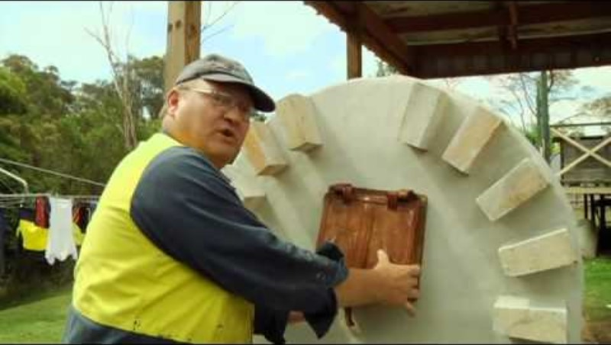
WATCH- I AM MISSION ZERO
Watch the following video highlighting employee engagement and how Interface embarked on the Mission Zero Goal. Click on the link below or on the image to play the video.
https://www.youtube.com/watch?v=spWuVxu16bM

Slide 101
Introduction
In an effort to reduce plastic waste, McDonald's decided to replace its plastic straws with paper ones in all of its UK and Ireland locations in 2018. This initiative was part of a broader movement to address the environmental impact of single-use plastics, aligning with growing consumer demand for more sustainable practices.
However, the paper straw replacement was met with several issues from the offset, highlighting the importance of conducting a full analysis of alternative materials. The main issues surrounding the new straws were to do with customer backlash, unrecyclable materials, and issues with durability.
Case Study 2
McDonald’s- Adapting To Paper Straws

Slide 102
Challenges and Issues
Despite being marketed as a more eco-friendly alternative, the paper straws introduced by McDonald's were found to be non-recyclable. The paper used in the straws was too thick to be processed by standard recycling facilities, unlike the plastic straws they replaced which were recyclable.
This revelation led to significant public criticism. Customers were instructed to dispose off the paper straws in general waste bins, which contradicted the initial sustainability goal of reducing waste. The paper straws were reported to perform poorly, becoming soggy and disintegrating quickly when used with beverages. This affected the customer experience negatively and further fueled the backlash against the initiative​.
Case Study 2
McDonald’s- Adapting To Paper Straws

Slide 103
Solution
The McDonald's case highlights the importance of thoroughly evaluating the entire lifecycle and recyclability of alternative materials before implementation. A sustainable solution should not only focus on the material change but also on its end-of-life processing.
Similarly, effective sustainability initiatives need to balance environmental benefits with maintaining or improving the user experience. The performance issues with the paper straws detracted from the positive impact of reducing plastic waste​.
Clear and honest communication with consumers about the limitations and advantages of new sustainable practices is crucial as it ensures that consumers are not misled and can fully support the initiatives​.
Case Study 2
McDonald’s- Adapting To Paper Straws

Slide 104
Outcome
Despite the setbacks, McDonald's continues to explore sustainable alternatives and improve its practices. The company remains committed to reducing its environmental footprint and is learning from these challenges to develop better solutions in the future.
Ensuring that alternative materials are genuinely more sustainable and by maintaining a high standard of product performance, companies can better achieve their environmental goals without compromising customer satisfaction.
Although this case is based on a corporation, the learning message is relatable to microbusinesses.
Find out more about this case by clicking here.
Case Study 2
McDonald’s- Adapting To Paper Straws

Slide 105
Problem:
In May 2021, Hefty, a brand under Reynolds Consumer Products, faced a class-action lawsuit for misleading consumers about the recyclability of its Hefty Recycling Bags. Marketed as being “designed to handle all types of recyclables,” the bags were intended to appeal to eco-conscious consumers looking for ways to reduce their environmental impact. However, these claims were soon called into question.
It turns out that although the bags were marketed for all types of recycling materials, the bags themselves were not recyclable and so in turn were contaminating any recycling loads that contained the bags.
Another major issue was around consumer deception, as the lawsuit claimed that consumers were being led to think that they were making eco-conscious decisions.
Case Study 3
Hefty Recycling Bags

Slide 106
Allegations of the Lawsuit:
The lawsuit alleged that Hefty Recycling Bags were not recyclable. Despite their marketing, the bags were made from plastic materials that could not be processed by standard recycling facilities. This meant that the bags, when mixed with other recyclables, often ended up contaminating the entire batch, leading to more waste being sent to landfills​. Instead of facilitating recycling, Hefty Recycling Bags were found to hinder the process.
Another core issue in the lawsuit was the deceptive marketing practices that misled consumers into believing they were making environmentally friendly choices. The lawsuit claimed that the branding and promotional materials violated California’s anti-greenwashing laws by falsely representing the product’s environmental benefits.
Case Study 3
Hefty Recycling Bags

Slide 107
Impact on the Brand:
The class-action lawsuit not only damaged Hefty’s reputation but also highlighted the potential legal risks of making unsubstantiated environmental claims. The plaintiffs sought damages for the misleading advertising, which could have significant financial implications for the company if they were found liable. The revelation that Hefty Recycling Bags were not as eco-friendly as advertised eroded consumer trust. Eco-conscious consumers, who are often willing to pay a premium for products they believe to be sustainable, felt deceived. This kind of breach of trust can lead to long-term damage to a brand’s image and customer loyalty. This case highlights how greenwashing can severely damage a brand’s reputation and consumer loyalty if not handled with integrity and honesty​. Click here to find out more
Case Study 3
Hefty Recycling Bags

Slide 108

Thank You
Any questions?
www.website.eu

