Slide 1
Start on Sustainability
Starter Kit
6. ASSESSMENT AND PLANNING
Start on Sustainability Erasmus+ VET Project © 2024 is licensed under CC BY 4.0
Disclaimer: Funded by the European Union. Views and opinions expressed are however those of the author(s) only and do not necessarily reflect those of the European Union or the European Education and Culture Executive Agency (EACEA). Neither the European Union nor EACEA can be held responsible for them.

Slide 2
ABOUT OUR PROJECT
By implementing Start on Sustainability, we aim to equip micro-enterprises with the necessary tools and resources to take meaningful action towards sustainability, thereby contributing to a more sustainable and resilient EU economy.

Slide 3
SOS Starter Kit Table of Contents
UNIT NAME | UNIT NAME
Introduction to the SOS Starter Kit | Unit 7- Supply Chain Transparency
Unit 1- Sustainable Business Operations | Unit 8- Benchmark Practices
Unit 2- Sustainable Thinking | Unit 9- Digital Tools
Unit 3- Engaging Staff | Unit 10- Pitfalls in Sustainable Businesses
Unit 4- Serving Green Consumers | Summary to the SOS Starter Kit
Unit 5- Community Partnerships | Key Terms and Definitions
Unit 6- Assessment and Planning | References

Slide 4
TABLE OF CONTENTS
01
Introduction to the module
02
Sustainable Business Operations
03
Case Studies
04
Assessment
05
Key terms and definitions
06
References

Slide 5
01
INTRODUCTION TO THE MODULE

Slide 6
01
OVERVIEW OF THE TOPIC
02
OBJECTIVES
03
LEARNING OUTCOMES

Slide 7
OVERVIEW
A sustainable future is possible only when it is pursued with a sense of urgency. Corporate sustainability of micro-SMEs requires management, strategies and operations that ensure the transition to a sustainable future.
This "Assessment and Planning" module provides answers to the new challenges and requirements that self-employed, entrepreneurs and micro-SMEs will face in order to grow in a sustainable way.
The growing awareness and demand for greater commitment by companies to environmental conservation requires micro-SMEs in different sectors to start deepening their knowledge of the main concepts, applications, methodologies, tools and requirements that sustainability encompasses.
They will have the opportunity to acquire knowledge about corporate sustainability, carbon footprint, circular economy, ESG, reporting, sustainable development goals and steps to follow to develop a Sustainability Plan.

Slide 8
02. OBJECTIVES
Overall Objective
To implement sustainable practices by micro-SMEs in their operations.

Slide 9
Specific Objectives
Provide a comprehensive Methodology for sustainability plans, aligned with ESG (Environmental, Social and Governance) criteria.
Raise awareness of the need for and benefits of strategic sustainability planning.
Disseminate good practices on sustainable business management.
To provide support for public initiatives and policies on sustainability in the European and Spanish context.
.

Slide 10
03. LEARNING OUTCOMES
Management commitment to the Sustainability Strategy.
The need to carry out a prior self-diagnosis.
The importance of measuring sustainable management through indicators for the fulfilment of sustainability objectives.
The value and influence of stakeholders.
Evaluation, control and monitoring of the Micro-SMEs Sustainability Plan.

Slide 11
02
SUSTAINABLE BUSINESS OPERATIONS

Slide 12
01
What is a Sustainability Plan and why is it Important?
02
Content of the Sustainability Plan
03
Legal and Reporting Obligations on Sustainability for Micro and SMEs
04
European-level Sustainability Certification or Advisory Bodies and Institutions

Slide 13
What is a Sustainability Plan and why is it Important?
A roadmap of "clear, measurable and realistic targets to improve organisational sustainability" aligned with the SDG 2030.
It engages all employees, managers, customers, suppliers and investors.
On an average, almost 8 out of 10 companies that developed a sustainability strategy/plan improved their environmental performance and their employee satisfaction levels, while more than 7 out of 10 saw improved customer satisfaction level.

Slide 14
What is a Sustainability Plan and why is it Important?
Benefits of implementing the Sustainability Plan for Micro-SMEs.
Improved corporate image and brand reputation.
Attracting investors.
Reduction of operating costs.

Slide 15
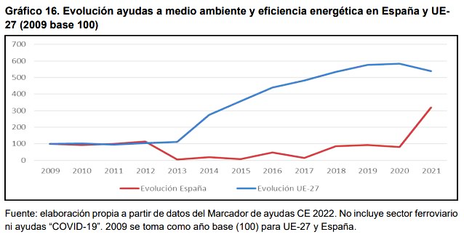
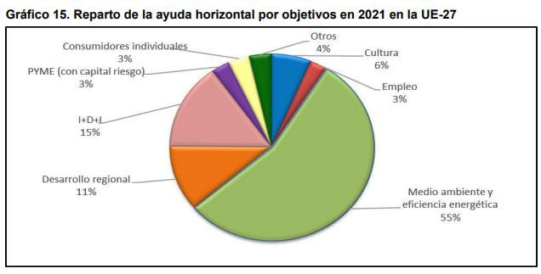
What is a Sustainability Plan and why is it Important?
Access to public funds: grants, subsidies, public sector contracts.
Since 2013, aid for the environment and energy efficiency in the EU has increased fivefold.
In 2021 they accounted for 55% of the total.
Evolution of aid for the environment and energy efficiency in the EU up to 2021 - source: Informe Anual de Ayudas Públicas (page 28). Comisión Nacional de los Mercados y de la Competencia. 14 de noviembre de 2023. IAP/CNMC/001/23.
Breakdown of horizontal (non-sectoral) aid by objective in the EU in 2021 - source: Informe Anual de Ayudas Públicas (page 28). Comisión Nacional de los Mercados y de la Competencia. 14 de noviembre de 2023. IAP/CNMC/001/23.

Slide 16
What is a Sustainability Plan and why is it Important?
Legal and reporting obligations on sustainability for micro-SMEs
Sustainability reporting will be mandatory for micro-enterprises from 2027, which may opt out of the regulation until 1 January 2028, when they will be required to report on sustainability issues for financial years starting on or after 1 January 2026 (Directive (EU) 2022/2464 of the European Parliament and of the Council of 14 December 2022 (CSRD)).
The sustainability report shall be verified by an external auditing company and in a standard electronic format that simplifies its inclusion in the Single European Access Point.

Slide 17
What is a Sustainability Plan and why is it Important?
How to make a Sustainability Plan step by step?
Step 1.- Initial diagnosis: assessment of environmental risks and opportunities for improvement.
Step 2.- Define Objectives and Action Plan
Specific
Measurable
Achievable
Realistic
Maximum deadline
Sustainability Plan
Strategic Objectives
Responsible
Resources
Deadlines
Indicators
Monitoring frequency
Action Plans

Slide 18
What is a Sustainability Plan and why is it Important?
Internal
employees
compromise
Step 3.- Communication of the sustainability plan.
participation
investors
External
clients
providers
Step 4.- Definition of Key Indicators for each Objective
They strengthen the strategies according to results.
Starting value and value to be achieved
Timeframe to achieve objectives.
most relevant indicators

Slide 19
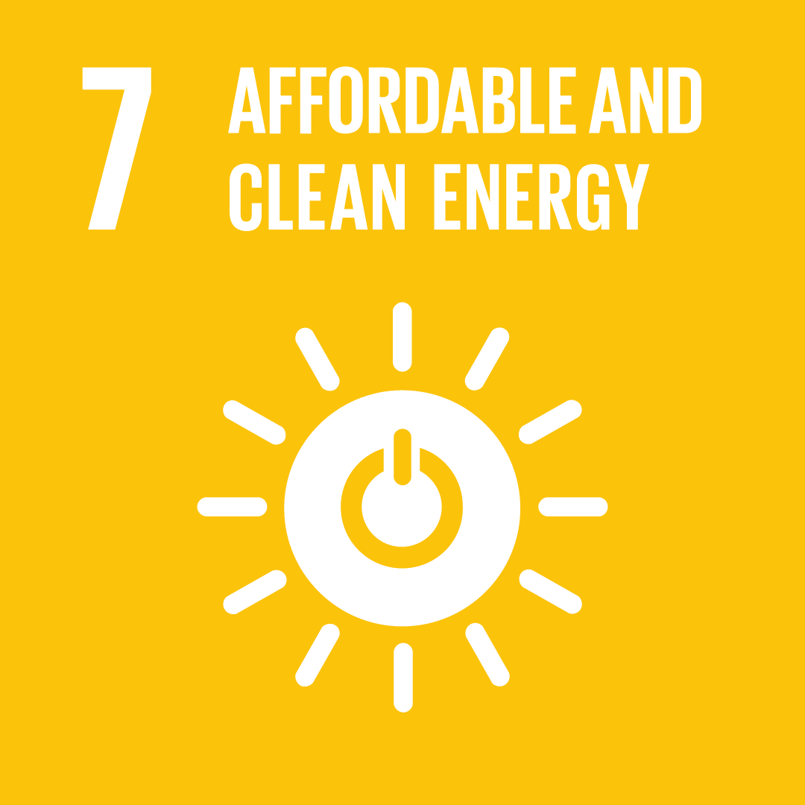
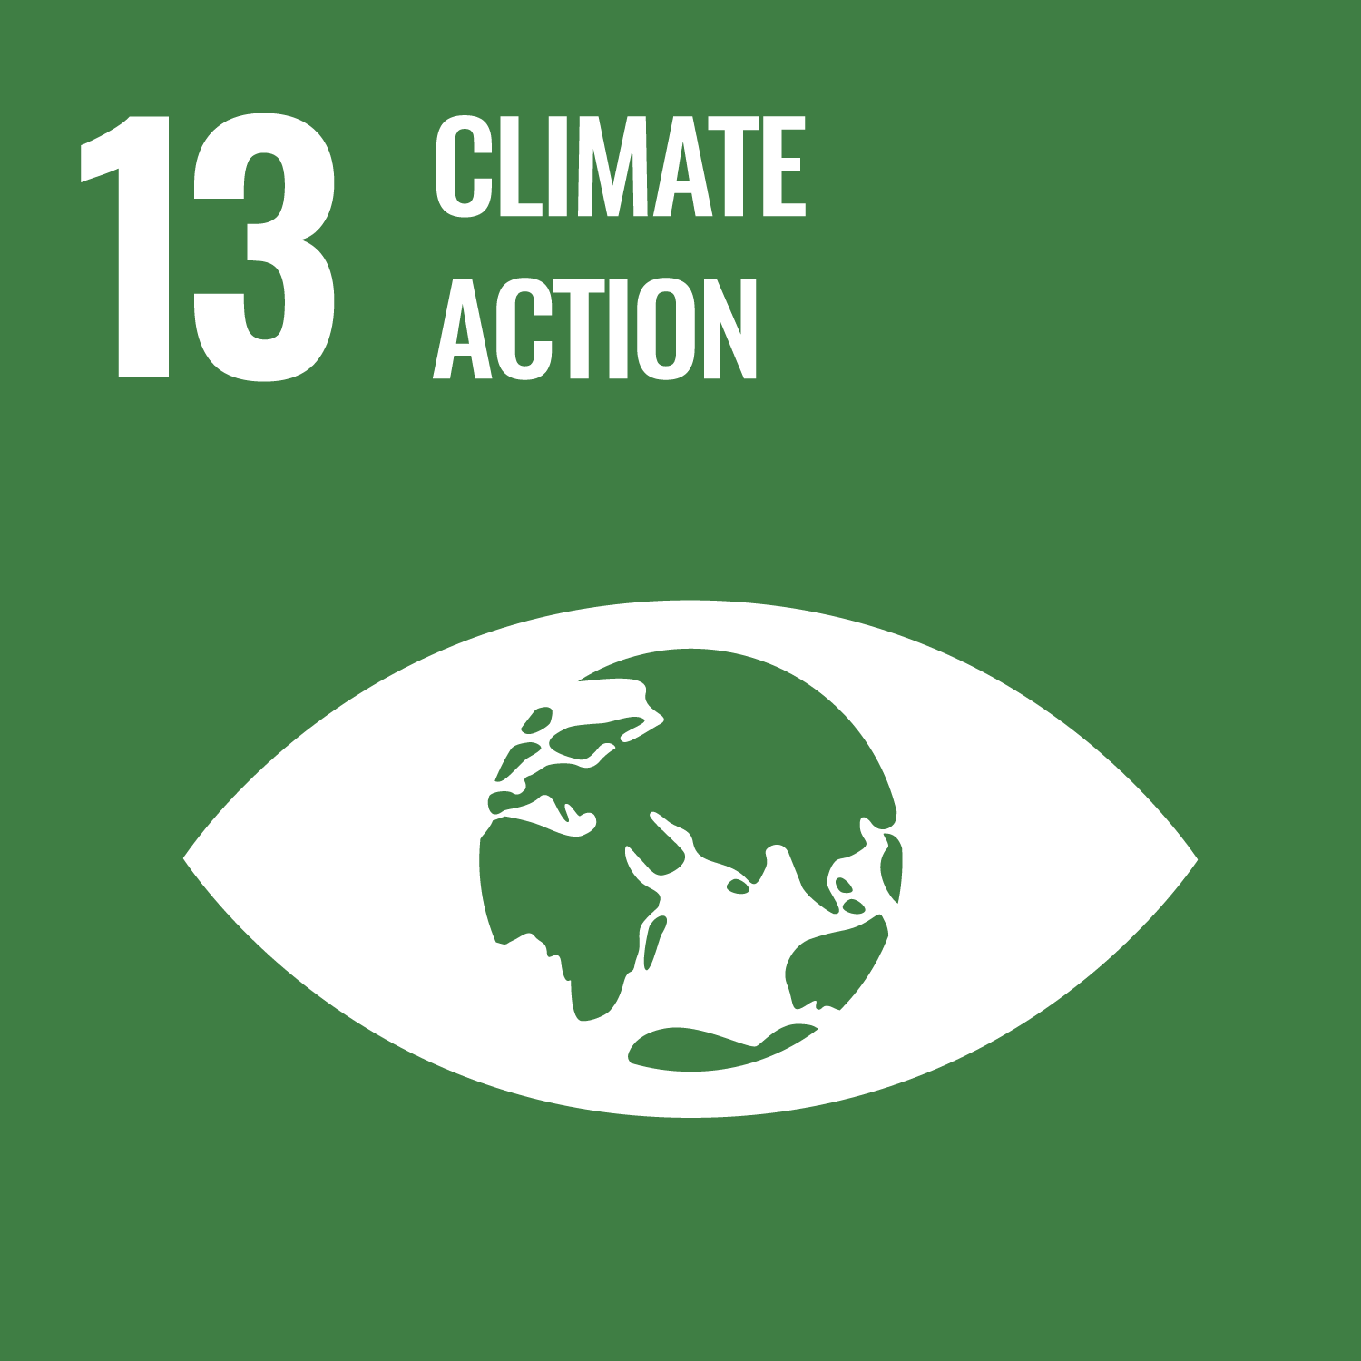
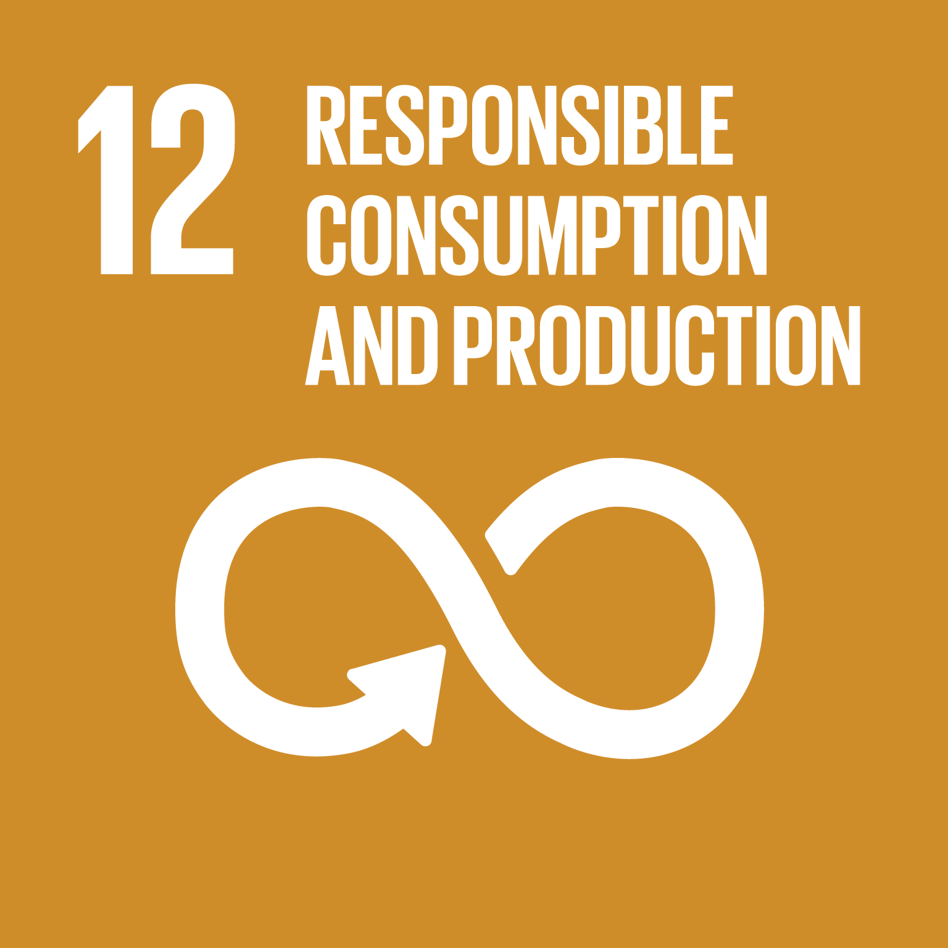
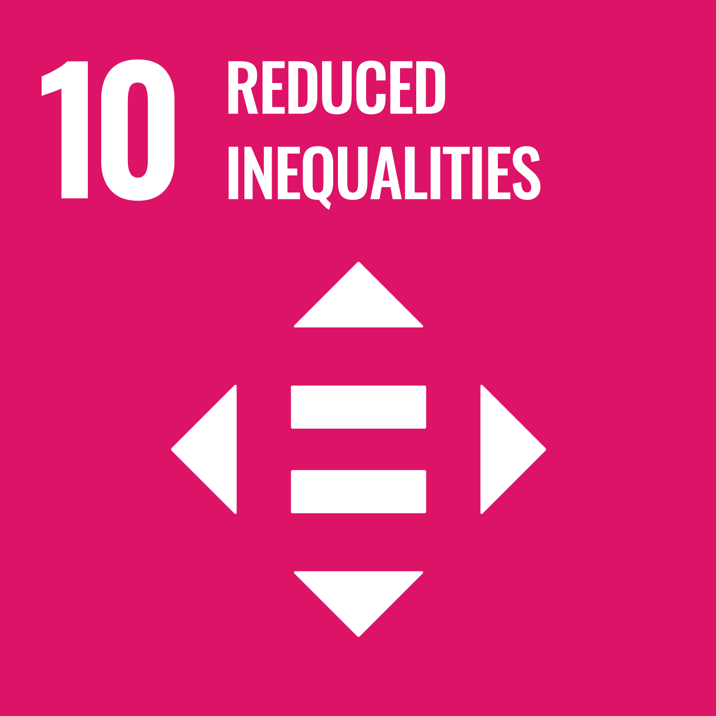
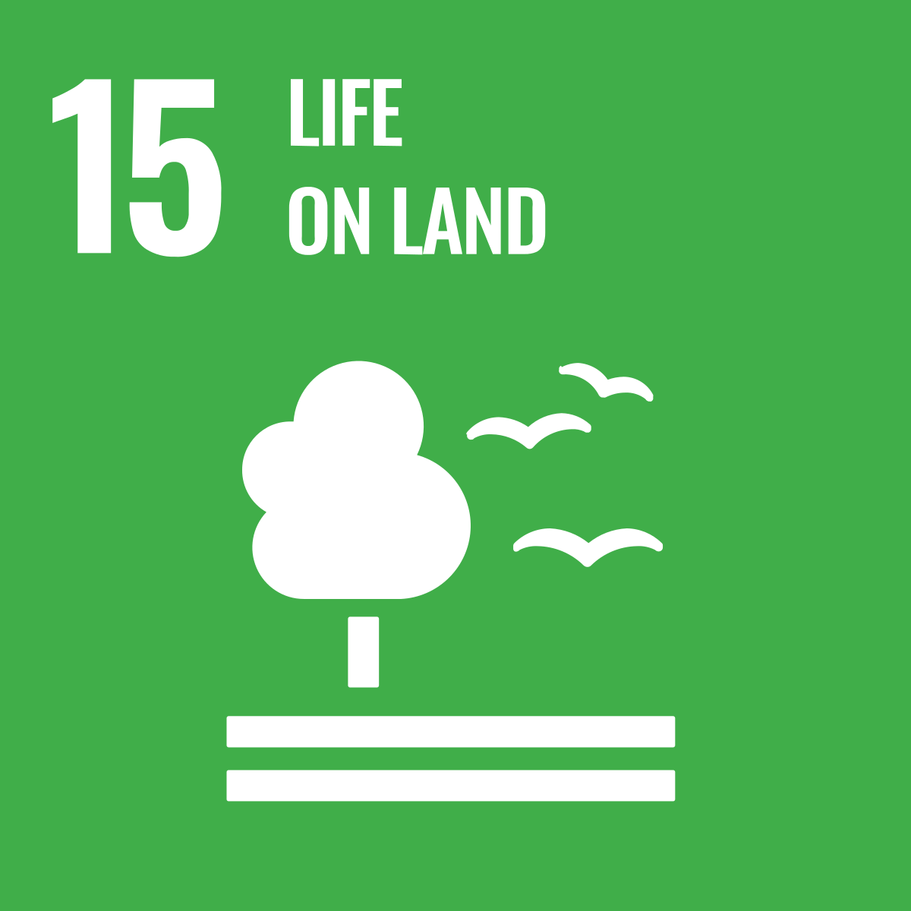
What is a Sustainability Plan and why is it Important?
MOST IMPORTANT INDICATORS
Environmental Sustainability
Measuring the use of resources and raw materials.
Measurement of the use of harmful substances.
Use of environmentally friendly products.
Social sustainability
Measurement of employee opinion.
Total number of employees in social projects.
Funds raised for social causes.
Financial sustainability:
Company balance sheet.
Share prices.
Labour risk management.
Accounting policies.
Expense liabilities and assets.
Budget evaluation.

Slide 20
What is a Sustainability Plan and why is it Important?
Step 5.- Implementation
Applying the Sustainability Plan to the daily Micro-SMEs management
Regular evaluations
Step 6.- Monitoring and Evaluation
Analysis of sustainability indicators
Dashboard
Evolution by objectives
Deviations from the initial estimated value

Slide 21
CONTENT OF THE SUSTAINABILITY PLAN:
Indicator
Working Standards
Environment | Greenhouse Gas Emissions in the year expressed (in million tonnes) Electricity consumption in the year expressed in total (kWh). Total water consumption (L/year) Recycling:
Providers | Proportion of expenditure on local suppliers Percentage of suppliers selected according to environmental, social and ethical criteria
Compliance | Number of sanctions received for tax non-compliance Number of confirmed cases of corruption and actions taken
Gender
New Contracts
Diversity: number of employees
Age
Working conditions
Professional classification
Rotation
Average number of days worked
Direct GHG emissions
Indirect emissions: by producing energy
% of recycled inputs
% of packaging recovered for each type of product

Slide 22
Legal and reporting obligations on sustainability for micro-SMEs
PROBLEMATICS | REGULATION
Energy Saving | Directive 2012/27/EU on energy efficiency. Directive 2018/2001 on the promotion of the use of energy from renewable sources. Regulation 2018/1999 on the governance of the Energy Union and Climate Action.
Water Saving | UNE-EN ISO 14046: Water footprint of products, processes and organisations.
Environmental Tags | EMAS REGULATION
Annex: ISO Standards

Slide 23
European-level sustainability certification or advisory bodies and institutions
Standards that allow micro-enterprises to communicate, through an independently certified label, their sustainability efforts.
Declarations of Adherence to an Initiative or Code of Conduct
Some of them are quite widespread and have a good reputation
Pros: Not subject to extensive third-party verification. Easy to implement and low cost
Cons: Usually have limited recognition

Slide 24
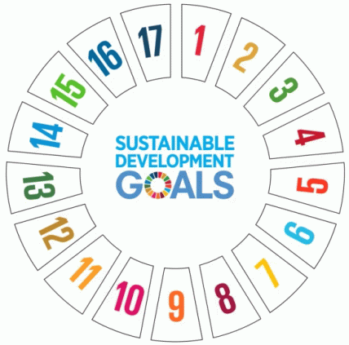
European-level sustainability certification or advisory bodies and institutions
The United Nations Global Compact is one of the most widespread initiatives today. It involves incorporating 10 principles of responsible management and the Sustainable Development Goals.
The OECD Guidelines for Multinational Enterprises and the ILO Declaration on Multinational Enterprises are also widely disseminated, but both are developed with multinationals rather than micro-SMEs in mind.

Slide 25
European-level sustainability certification or advisory bodies and institutions
Certifiable standards. Certifiable standards are subject to verification by an independent body of compliance with a number of requirements.
Standards covering the overall management of the company
AA1000
IQNet SR 10 Standard
BCorp Certification
The most important ones
SGE 21 Standard. Ethical and socially responsible management system.

Slide 26
European-level sustainability certification or advisory bodies and institutions
Standards that concern only a specific field of activity

Slide 27
European-level sustainability certification or advisory bodies and institutions
Seals associated with products speak of the characteristics of the product or service certified by an independent entity.
Type III Environmental Declarations
2. Labelling according to ISO standards
construction products
Three labelling systems
Type II Ecolabel
Type I Ecolabel (ISO 14024)
Environmental self-declarations
3. ECOLABEL
Reliable mark, verified through third party checks, for more than 20 different categories of products and services which are regularly updated.

Slide 28
European-level sustainability certification or advisory bodies and institutions
Emblem of the international Fairtrade system and the most recognised ethical label worldwide. When you buy products with any of the FAIRTRADE seals, you support farmers and workers to improve their quality of life and that of society as a whole.
4. Fairtrade seal
The Ecolabel adds value to the competitiveness of companies, large or small, by highlighting the eco-efficiency and environmental excellence of those that obtain it.
respon It ensures the responsible sourcing of a wide variety of forest-based products from all over the world, starting with the forest of origin, through all the companies involved in their production and packaging, all the way to the consumer.
5. FSC seal

Slide 29
European-level sustainability certification or advisory bodies and institutions
7. EU ECO seal
The label is awarded to products and services that have a reduced environmental impact compared to other similar products and services on the market, taking into account their entire life cycle.
6. Environmental Technology Verification (ETV)
A tool that verifies the performance of innovative technologies with an environmental character. Its main objective is to facilitate the market entry of new innovative technologies that have an environmental benefit compared to existing technologies.

Slide 30
"I am pushing young people to be social enterprise entrepreneurs and contribute to the world, rather than just making money. Making money is not fun, contributing and changing the world is much more fun".
Muhammad Yunus. Nobel Peace Prize

Slide 31
03
CASE STUDY

Slide 32
01
Case study 1: VOLCÁN STUDIO

Slide 33
Case study 1: VOLCÁN STUDIO
Volcan Studio is an architecture, engineering and design studio founded in 2015. Since its beginnings, it understands project management through a global vision where formal, graphic and material creation is nourished by a multidisciplinary approach.
Architecture is at a turning point in its evolution in the Canary Islands. Combining design, functionality and technique, it has a determining impact on the environment in which the company is located.
Therefore, while Volcán Studio is building the urban landscape and renovating the spaces, two key terms emerge: sustainability and accessibility.
CASE STUDY 1

Slide 34
Sustainability is not only about building environmentally friendly buildings, but also about constructions that can last over time, generating a positive impact on their surroundings.
On the other hand, accessibility seeks to make these spaces universal, so that citizens can enjoy them, regardless of their physical or sensory abilities and how these change as the population ages.
Looking into the future, there is a firm commitment towards these two dimensions, which are considered cornerstones in the architectural development of the Canary Islands and the world.
CASE STUDY 1

Slide 35
And not just because they represent the right thing to do in ethical terms, but because they are the answer to the demographic and environmental challenges we will face in the near future.
Volcán Studio believes that the best way to do this is to keep up with the times by incorporating the necessary technology and the necessary knowledge that allows them to move forward on a sustainable and accessible path.
A good example of this is the participation in the "Aje Verde" programme, where they were made aware of the management of materials and the implementation of future legal regulations and national and international quality labels.
CASE STUDY 1

Slide 36
With the aim of advancing along this path and being a meeting point for professionals and knowledge, the initiative "Canarias Arquitectura Sostenible" (Canary Islands Sustainable Architecture) was born, which Volcán Studio joins.
It aims to give visibility to the initiatives arising from the Canary Islands and which are adapted to the particularities and singularities of the territory.
https://canariasarquitecturasostenible.com/
volcanstudio.com
CASE STUDY 1

Slide 37
"Sustainable leadership reflects an emerging awareness among people who are choosing to live their lives and run their businesses in a way that takes into account their impact on the planet, society and the health of local and global economies”.
Mary A. Ferdig
International Leadership and Develop

Slide 38
04
ASSESSMENT

Slide 39
Q1
The Sustainability Plan
Is a sustainability policy document not subject to the SDGs 2030, sufficient to comply with the regulations and government guidelines of each country.
It is a guide of clear, measurable and realistic objectives to improve the sustainability of the organisation aligned with the SDG 2030.
It is a document designed under the guidelines of the company without being aligned with any European and national regulations.

Slide 40
Q2
The Sustainability Plan should involve
Only the management team.
All employees, managers, customers, suppliers and investors.
Only persons (internal and external) designated by management.

Slide 41
Q3
When will sustainability reporting be mandatory for micro-enterprises?
From 2027 but they can opt out until 1 January 2028.
From 1 January 2025.
No obligation has yet been established in time.

Slide 42
Q4
The sustainability report shall be verified
By an external auditing company without being subject to a standard template.
Not required to be verified.
By an external auditing company and in a standard electronic format that simplifies its inclusion in the Single European Access Point.

Slide 43
Q5
In order to monitor compliance with the Sustainability Plan, it is essential to:
Carry out periodic evaluation, monitoring and control actions.
Design, implement and analyse a system of indicators that, within the framework of a scorecard, provides information on the evolution by objectives and deviations with respect to the estimated value.
All are correct.

Slide 44
Answer Key
Q1: B
Q2: B
Q3: A
Q4: C
Q5: C

Slide 45
"What we do today affects future generations".
Jane GoodAll
United Nations Messenger of Peace

Slide 46
05
KEY TERMS AND DEFINITIONS

Slide 47
Corporate Social Responsibility/Corporate Social Responsibility (CSR/CSR): Business principle that seeks to balance business objectives such as productivity and profitability without forgetting ethical and legal principles.
ESG criteria: They refer to Environmental, Social and Governance factors that are taken into account when investing in a company. ESG stands for "environmental, social and governance".

Slide 48
Environmental Footprint: The Environmental Footprint evaluates the environmental impacts of a product or service, based on a Life Cycle Assessment (LCA), which is done according to international ISO standards (ISO 14040 and ISO 14044).
Non-Financial Information: Sustainability Report: Micro-SME management report providing information on environmental, personnel, human rights, due diligence and sustainability issues.

Slide 49
European Ecolabel (EEE): Certification scheme managed by the EU Ecolabel Committee. It is awarded when products meet ecological and performance criteria.
Circular Economy: A model of production and consumption that involves reducing the waste of resources. It extends the life cycle of products.
Climate Neutrality: Consists of offsetting greenhouse emissions with processes that fix atmospheric carbon.

Slide 50
"Where there is a tree to plant, you plant it; where there is wrong to be righted, you mend it; where there is an effort that everyone else shirks, you do it.
Be the one who moves the stone out of the way".
Gabriela Mistral
Nobel Prize in Literature

Slide 51
06
REFERENCES

Slide 52
REFERENCES
Publications:
AQUA, ACPUA (2019). Proposal for indicators to incorporate the SDGs into institutional quality assessment processes.
Ayuso, A. (2017). Participation and accountability in the localisation of the 2030 Agenda. CIDOB Monographs Collection 2017.
European Commission (2007). Roadmap for the European Sustainable Development Strategy. A sustainable future within reach (pdf).
European Commission (2017). White Paper on the Future of Europe.
European Commission (2017). European Pillar of Social Rights.
European Commission (2019). Reflection paper for a sustainable Europe by 2030.

Slide 53
REFERENCES
GRI, UN Global Compact, WBCSD (2016). SDG Compass. The roadmap for business action on the SDGs.
Gudynas, (2010). Sustainable development: a basic guide to concepts and trends towards another economy.
United Nations (1948). Universal Declaration of Human Rights.
United Nations (1987). Report of the World Commission on Environment and Development. "Our Common Future" (Brundtland Report).

Slide 54
REFERENCES
Webs:
www.consilium.europa.eu
www.eesc.europa.eu
www.pactomundial.org
www.sustainabledevelopment.un.org
www.wtwco.com
www.redeuroparc.org

Slide 55
"Think globally, act locally".
Jacques Ellul. Philosopher

Slide 56
07
Exhibit: ISO Standards

Slide 57
Annex: Outline of ISO standards
Emissions and carbon footprint | 14064-1 14064-2 14064-3 14065 14066 14067 | Quantification and reporting of greenhouse gas emissions and removals
Energy Savings | 50001 50002 50003 50004 50006 50015 | Energy management systems and energy audits
Water Savings | 14046 | Water footprint of products, processes and organisations.
Environmental Labels | 14001 | Environmental management system in the company
 | 14025 14020 | TYPE III environmental labels and declarations
 | 14020 | Environmental Labels: General Principles
 | 14054 | Environmental self-declarations. Type II environmental labelling.
 | 14024 | Tipe I environmental label
 | 14040 14044 | Product life cycle analysis
Wood Sector | 9001 | Traceability of Wood Products
Corporate Social Responsibility | 26000 | It is a guide. Not certifiable. Human Rights.

Slide 58
Thank You
Any questions?
www.website.eu

